Slide 1

PREVENTION OF STRAINS, SPRAINS, AND MATERIAL HANDLING INJURIES IN CONSTRUCTION
INSERT SPEAKER NAME, TITLE, AND
ORGANIZATION INFORMATION
*Through the OSHA Alliance Program, this presentation was developed by members of the Alliance Program Construction Roundtable for informational purposes only. It does not necessarily reflect the official views of OSHA or the U.S. Department of Labor. (June 2010)
Notes:
This presentation will address the prevention or reduction of strains, sprains, and material handling injuries in construction.
Through the OSHA Alliance Program, this presentation was developed by members of the Alliance Program Construction Roundtable for informational purposes only. It does not necessarily reflect the official views of OSHA or the U.S. Department of Labor.
Any tasks that puts stress on the body has the potential to cause a strain, sprain, or musculoskeletal injury. Such potential hazardous tasks include gripping, kneeling, lifting, working in an awkward position, applying force, repeated movements, bending, working overhead, twisting, using vibrating equipment, squatting, or over-reaching

Slide 2
Overview
  OSHA Alliance Program and Construction Roundtable
  U.S. Construction Injury Statistics
  Planning the Work
  Safe Practices
    Working at Ground Level
    Working Overhead
    Lifting
    Tools
  Resources
Notes:
This presentation provides:
a description of the OSHA Alliance Program and its Construction Roundtable
BLS statistics on strains, sprains, and overexertion injures
safety principles and examples of reducing strains, sprains, and material handling injuries in construction starting with planning the work
additional resources

Slide 3

The Alliance Program
OSHA’s Alliances:
Established by OSHA’s National, Regional, Area Offices
Formed with a variety or organizations, including associations, unions, consulates, community and faith-based groups, and educational institutions, and government agencies
Develop and disseminate compliance assistance products
Educate workers and employers about their rights and responsibilities
Do not include an enforcement component
Notes:
The Alliance Program was launched in 2002 to reach workers and employers that were not being reached by OSHA’s other cooperative programs.
Through the Alliance Program, OSHA works with groups committed to worker safety and health to prevent workplace fatalities, injuries, and illnesses. OSHA and the groups work together to develop compliance assistance tools and resources, share information with workers and employers, and educate workers and employers about their rights and responsibilities.
Alliance agreements do not include an enforcement component, such as exemption from general scheduled inspections or monitoring visits. Alliance agreements are not worksite-based – they generally focus on entire industries or hazards within the industries.

Slide 4
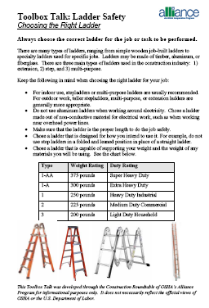
OSHA Alliance Program Construction Roundtable
Purpose
Participants
Products
Picture of Toolbox Talks: Ladder Safety
Notes:
OSHA formed the OSHA Alliance Program Construction Roundtable in 2004 to provide participants with the opportunity to share construction-related information about Alliance-related activities and successes, develop products, and network with others in the Program.
The Construction Roundtable developed the following products related to design for construction safety:
Design for Construction Safety Web site. Through the Roundtable's Design for Safety Workgroup, construction-related Alliances worked together to develop a Design for Safety Web site that provides information on the barriers to designing for safety, and how to overcome the barriers.
“Introduction to Designing for Construction Safety.” Through the Roundtable's Design for Safety Workgroup, a presentation was developed which informs the public about the process of addressing site safety and health in the design of a construction project.
Design for Construction Safety 2-4 Hour Course. Through the Roundtable's Design for Safety Workgroup, a course was developed based on the “Introduction to Designing for Construction Safety” presentation. It provides technical information for those who are interested in learning more about designing for safety. The presentation is located in the “2-4 Hour DFCS Presentation” section on the CI-ASCE Design for Construction Safety Web site.
Presentations addressing design for safety issues have been given by the workgroup’s representatives during a number of workshops and conferences.
Case Study. "Washington Group International Designs and Builds a Mixed-Waste Treatment Facility." OSHA. February 2007. This case study describes how the Washington Group International, Inc. incorporated its design for safety process into the construction of the U.S. Department of Energy's Advanced Mixed Waste Treatment Facility in eastern Idaho. (The Washington Group International is now known as the Washington Division of URS Corporation).
The Construction Roundtable developed the following products on fall protection:
“Prevention of Fall Fatalities and Injuries in Construction” (Sep. 2008). This slide presentation is available in English and Spanish. The presentation focuses on the top causes of falls in the construction industry and provides fall prevention guidance for design engineers, contractors, and workers.
Fall Protection Safety Tips Sheets for Employers and Employees. Through the Roundtable's Fall Protection Workgroup, IEC worked with other construction-related Alliances to develop Tips Sheets for employers and employees that describe general safety tips to help prevent fall-related injuries.
“Fall Protection.” Through the OSHA Alliance Program Construction Roundtable's Fall Protection Workgroup, a presentation was developed by the SWR Institute addressing fall protection issues in construction industry including fall protection systems. The presentation is available in English and Spanish.
Toolbox Talks Focusing on Ladder Safety. Through the Alliance Program Construction Roundtable's Fall Protection Workgroup, the Workgroup developed a series of toolbox talks focusing on ladder safety.

Slide 5
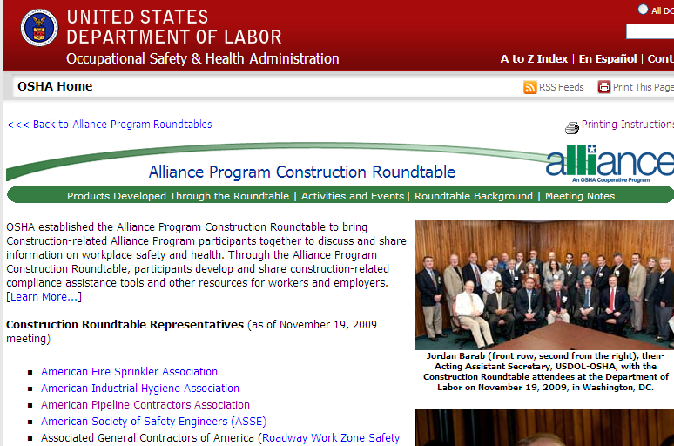
OSHA Alliance Program Construction Roundtable – Web Page
Screen Capture of OSHA’s Alliance Program
Construction Roundtable Web Page
Notes:
5
For the latest on the OSHA Alliance Program’s Construction Roundtable, including Roundtable products, visit the Construction Roundtable Web page on the OSHA Web site.

Slide 6
U.S. Construction Injury Statistics¹
371,700 non-fatal injuries per year (9.7% of total private industry workforce)
Sprains and strains 32.8%
Back 23.5%
Upper Extremities 23.5%
Lower Extremities 25.4%
Overexertion 17.4%
28% of workers missed 31 days or more
¹ Bureau of Labor Statistics-2007
Notes:
Unfortunately, as many of us know, construction is one of the most dangerous industries to work in. There are about 371,300 non-fatal injuries a year, 9.7% of the total workforce.
Here are some of the 2007 BLS statistics:
Sprains and strains make up 32.8% of the non-fatal injuries
Back injures are 23.5%
Upper and lower extremities make up almost 50%
Overexertion are 17.4%
28% of workers missed 31 days of more

Slide 7

Reducing Sprains, Strains, and Material Handling Injuries Requires Planning
Notes:
Reducing sprains, strains, and material handling injuries requires planning.
Each job task should be analyzed. Materials need to be staged where they can be easily accessible, with minimal material handling. Mechanical equipment should be used whenever possible. Planning for mechanical equipment would include providing ways for the equipment to service the site.
Each job task should be broken down. Tools should be provided that reduce bending, stretching, and reaching. Tools should be checked to be sure they are in good condition.
Workers should be assigned based on their physical abilities. This actually goes against the ergonomic principle of fitting the job to the worker, not the worker to the job. However, in construction this is not always possible as many construction tasks do require certain physical abilities. Lifting tasks should be analyzed to be sure the weight is not hazardous. Generally, under ideal circumstances anything heavier than about 50 pounds is hazardous but the situation such as position of the load, frequency of lifting, handholds, and duration of task can reduce this value.

Slide 8
Plan the Work
Instruct workers to notify their supervisor if they feel a task is beyond their capability or if they feel pain while performing a task
Have workers start with stretching, gently moving through a range of motions
Do a Job Hazard Analysis to identify hazardous tasks.
Notes:
A stretching program is recommended in which workers gently move through a range of motion.
A job hazard analysis is an analytical tool that can help in the planning and identify hazardous conditions and tasks

Slide 9
Job Hazard Analysis
A job hazard analysis is a technique that breaks each
job down into individual tasks to identify the hazards.
It focuses on the relationship between the worker, the
task, the tools, and the work environment.
Notes:
A job hazard analysis is a technique that breaks each job down into individual tasks to identify the hazard(s). It focuses on the relationship between the worker, the task, the tools, and the work environment. Once the hazards are identified, steps can be taken to eliminate the hazard or reduce the risk of an injury.
There are many references on job hazard analysis. The next slide shows a simple example to illustrate the procedure.

Slide 10
Job Hazard Analysis Example: Drywalling
Task Hazard Protection/Prevention
Carrying sheets of Back strain Have materials delivered
drywall to levels by supplier
Anyone working alone will
use a panel lifter
Attaching drywall Injuries to lower Use scaffolding
back Use drill extension
Notes:
Here is a simple example of a job hazard analysis for drywalling. Although there are many more steps to drywalling than what is shown here, two of the tasks involved lifting the drywall and attaching it (screwing it into place).
One of the hazards with lifting and carrying drywall is a back injury. The preventive measure would include having the drywall sheets delivered to each level by the supplier. A panel lift should be provided to anyone working alone.
One of the hazards associated with attaching (screwing) the drywall is a lower back injury. Preventative measured would include providing scaffolding so that workers do not have to reach or bend over. Drill extensions can also be provided to so that workers do not have to over reach, bend over, or over extend.
This simple example illustrates the job hazard analysis procedure. An actual analysis would be much more detailed and extensive. A separate analysis should be done for every conceivable job task.

Slide 11
Planning - Material Handling
Are there heavy materials that will be handled on site?
Do workers lift more than 50 pounds without help?
Are there handles to help carry materials?
Are the carts or dollies available?
Do any of the job task require lifting overhead or working on items above shoulder height?
Where will the materials be staged?
Notes:
This slide lists some of the questions that should be asked when planning material handling tasks.

Slide 12
Planning - Tools
Are tools sharp and in good condition?
Which tools vibrate?
Do all tools have proper handles?
Which tools require bending of the wrist?
Notes:
This slide lists some of the questions that should be asked regarding tools.

Slide 13
Planning - Repetitive Work
Which tasks use the same motion over
and over for more than 1 hour each day?
Notes:
One of the questions that should be asked is: “Are there any tasks that use the same motion over and over for more than 1 hour each day?” If so, then preventive measures may need to be taken. Workers should be alternated in and out of the job, or the task may need to be re-defined, or rest breaks may need to be added.

Slide 14
Planning - Awkward Positions
Which jobs require work above shoulder level?
Which jobs require work at floor level?
Which jobs require workers to stay in one position for a
long time?
Which jobs require a lot of bending and twisting?
Notes:
These are some more questions that should be asked.

Slide 15
Planning - Walking and Working Surfaces
Are working and walking surfaces clean and dry?
Are working and walking surfaces unobstructed?
Are working and walking surfaces even?
Are aisles clear and wide enough for carts, dollies,
forklifts to pass through?
Notes:
Many injuries occur from slips, trips, and falls.
Working and walking surfaces should be clean, dry, and unobstructed.
Walking surfaces should be even, any abrupt changes in elevation that could cause a worker to trip should be eliminated or corrected.
Aisles should clear and wide enough for carts, dollies, and forklifts to pass through so that manual lifting can be kept to a minimum.

Slide 16

Working at Ground Level
Prolonged or repeated work activities in the crouching/kneeling position causes reduced blood flow to the lower extremities and contact pressure injuries to the part of the knee coming into contact with hard surfaces.
Bending, stooping, kneeling, or squatting can stress your lower back or knees.
Notes:
Bending, stooping, kneeling, or squatting can stress your lower back or knees.
Your spine runs from the top of your neck down to your lower back. It is made up of vertebrae, joints, and discs. Every time you bend forward, your back muscles have to work harder, the disc gets compressed, and press on parts of the spine. When bending or twisting is done over and over for a number of years, the disc are weakened, a back injury can occur.
Similarly, every time your bend your knees, the tendons are stressed. Repeated stooping, kneeling, or squatting can increase the risk of bursitis, tendonitis, or arthritis in the knee.

Slide 17
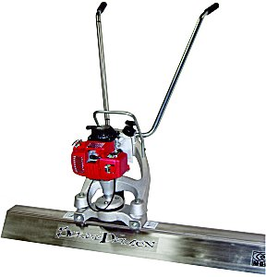
Working at Ground Level - Motorized Concrete Screeds
Screed concrete standing up instead of bending over
Notes:
Floor level work cannot be eliminated from construction, but it is possible to make the work easier on the body. This is done by, in effect, bring the work up to waist level.
When you hand screed concrete you bend over and have to grip the board and pull it over the concrete. This puts stress on your back, knees, hands, arms, and shoulders.
With a motorized creed as shown in this photo, you can stand upright. There is no stooping and little repeated arm or shoulder movement.

Slide 18
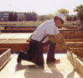

Working at Ground Level - Change Positions
Change positions when working at ground level and use knee pads
Notes:
Ground level work cannot be totally eliminated from construction.
Kneeing on a hard surface puts an lot of pressure on the knee. Squatting puts stress on the tendons, ligaments, and cartilage of the knee joint.
When kneeing must be done, change positions frequently, don’t bend the knee so far, and use knee pads.

Slide 19
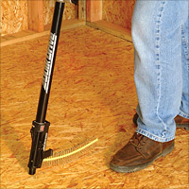
Working at Ground Level -
Stand-up Screw Guns
Fasten sub-floor standing up instead of stooping over
Notes:
Instead of stooping over to fasten or screw sub-flooring, use a stand up screw gun. This has the effect of bringing the work up to waist level. There is no stooping or bending.

Slide 20
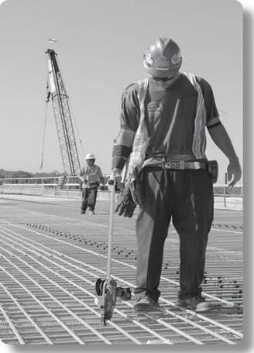
Working at Ground Level -
Tie Rebar Standing Up
Tie rebar standing up instead of stooping over
Notes:
Construction workers usually tie rebar at ground level with pliers and wire.This requires repeated, fast, hand and arm movements while stooping and bending over.
Tying rebar by hand increases the change of hand and wrist injuries due to the high force that is applied by the hand and the rapid movements,
Use a rebar tying tool as shown in the photo. Tying rebar can be done standing up. It eliminates the rapid hand movements.

Slide 21
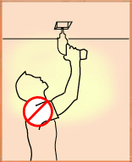
Working Overhead
Working with the elbow above
shoulder height for prolonged
periods can trap nerves and blood vessels under bone and muscle
Repeatedly lifting or applying force with arms above shoulder level can strain the muscles and tendons of the shoulder and neck
Notes:
Many construction jobs require working overhead, reaching up with one or more arms above your shoulders.
Lifting, raising, or using heavy tools or objects while your arm is raised is strenuous because your arms are less able to supply the force because of bad alignment.
Shoulder injuries can occur from over working the shoulder.
Neck injuries can also occur from frequently bending the neck backwards.
Unfortunately, overhead work cannot be eliminated, but there are some preventative measures that can be taken.

Slide 22
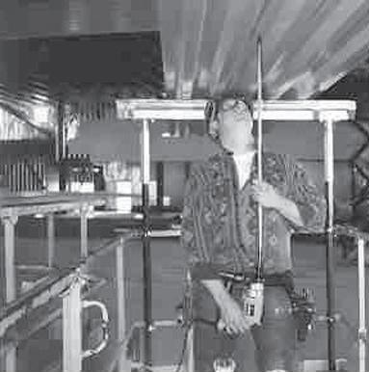
Overhead Work -
Extension Shafts for Drills
Using a shaft extension on a hand drill eliminates need to reach
Notes:
An extension shaft for drills allows you to, in effect, bring the work down to waist level. You work in a more neutral posture which lessens the strain on your arms, neck, and shoulders. You want to work with your arms close to your sides.

Slide 23
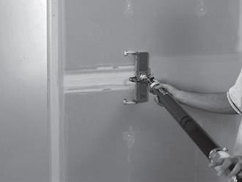
Overhead Work -
Pneumatic Drywall Finishing
Finish drywall standing up, less wrist and arm movement
Notes:
Drywall finishing requires a lot of bending, twisting, and reaching. There is lot of hand effort and repetition.
Using a pneumatic drywall finishing tool requires less effort. Your don’t have to bend over or reach as much. There is far less hand effort because you don’t need to hand pump the joint compound.

Slide 24
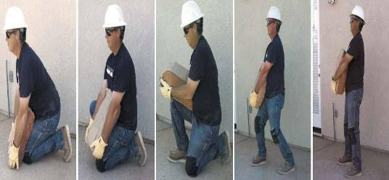
Principles of Manual Lifting
Keep load close to your body
Keep load in front of you
Lift with your legs
Notes:
Workers spend a lot of time on construction sites lifting, carrying, pulling or pushing various loads. If you lift materials for a long period of time, or if you lift an object that is heavy, you run the risk of a back injury.
If you have to lift, lift with your legs. Keep your back as straight as possible. Keep the load close to your body. Do not reach more than 10 inches from your body. Do not twist your body. Lift with a two hand grip.
As you can see in this sequence of photos, the worker leans into the sack, he slides it up, keeps it close to his body, then stands up to lift the sack using his legs.

Slide 25
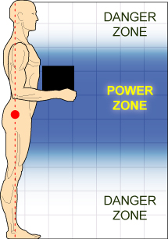
Manual Lifting - Power
Zone
The power zone for lifting is
close to the body, between
mid-thigh and mid-chest height.
Notes:
Any lifting from above mid-chest or below mid-thigh can be dangerous.
The power zone, the zone between the mid-thigh and mid-chest is where the arms and back can lift the most with the least amount of effort.
When lifting, try to work in your power zone.

Slide 26
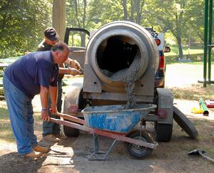
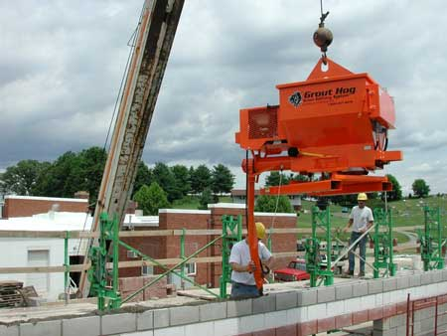
Lifting, Holding, and Handling Materials - Deliver Grout Mechanically
Deliver grout mechanically instead of with buckets or wheelbarrows
Notes:
When workers have to manually mix and deliver grout in the traditional way, there are risks of back and shoulder injuries. There is a lot of bending, twisting, stooping, and picking up heavy bags at or near ground level. Pushing cement laden wheelbarrows is strenuous.
Using mechanized mixing and delivery equipment can eliminate much of this stress on the body. The grout is mixed in a cement mixer and delivered mechanically.

Slide 27
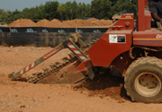
Lifting, Holding, and Handling Materials - Use Mechanical Equipment for Digging
Use a trencher or backhoe for digging trenches
Notes:
Similarly, digging a trench by hand puts stresses on the back, legs, knees, shoulders, arms, and hands. There is a lot of bending over and stooping. Using a mechanical trencher or backhoe eliminates most if not all of this stress on the body.

Slide 28
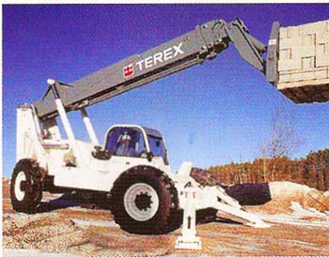
Lifting, Holding, and Handling Materials - Use Mechanized Equipment to Stage Materials
Use a lull or aerial lift to stage materials at high levels or onto the bed of trucks
Notes:
The more materials that can be staged using mechanical equipment, the less manual lifting that must be done by the worker.

Slide 29
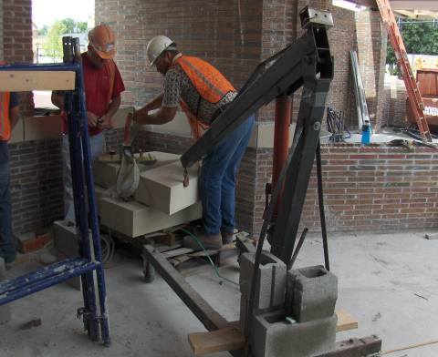
Lifting, Holding, and Handling Materials - Lift from Power Zone
Lift from power zone, mid thigh to mid chest
Use two or more people to lift heavy objects
Use mechanical equipment to lift and move materials
Grasping devices can
be helpful when lifting
Notes:
Use two or more people to lift heavy objects. Use mechanical equipment to lift and move heavy objects.

Slide 30
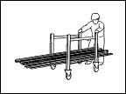
Lifting, Holding, and Handling Materials - Use Dollies or Carts
Use a plank cart to transport planks rather than carrying by hand
Notes:
Carts and dollies should be used to move materials rather than carrying.
The work needs to be planned so that aisles are wide enough and clear to move carts in and out.

Slide 31
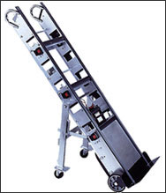
Lifting, Holding, and Handling Materials - Use Manual Hand Trucks
Manual hand trucks can be used to move materials over long distances. Stair climbing hand trucks can be used to move materials up and down stairs.

Slide 32
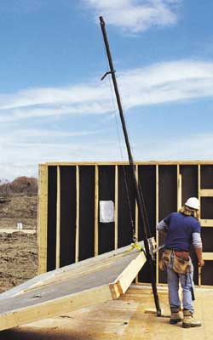
Lifting, Holding, and Handling Materials - Use Wall Jack
Small crews can benefit from the use of wall jacks when lifting partitions into place
Notes:
A worker working by himself, or small crews can benefit by using wall jacks to lift partition into place rather the one or two workers trying to do it themselves.

Slide 33
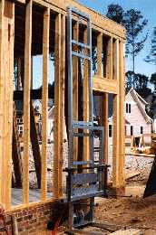
Lifting, Holding, and Handling Materials - Use Motorized Lift for Plywood, Lumber, and Masonry
Motorized Lift Reduces Material Handling and Stress on Back
Notes:
Similarly, the use of motorized lifts means that a worker or workers aren’t manually lifting awkward, heavy materials such as plywood, lumber, or masonry. This tool can lift plywood up to the roof.

Slide 34
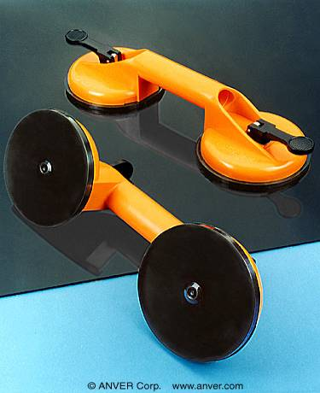
Lifting, Holding, and Handling Materials - Use Vacuum Handles or Vacuum Lifters
Use vacuum handles to pick up sheets of material
Eliminates handling sharp edges and bending or stretching across large sheets.
Notes:
Vacuum lifters provide a convenient handhold for lifting materials.
The lifters eliminate the risk of an injury from grapping or holding a sharp edge.
The body does not have to bend or twist as much when handling large sheets of materials.

Slide 35
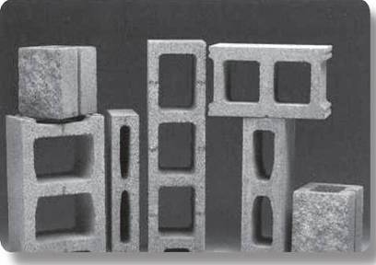
Lifting, Holding, and Handling Materials - Specify Lightweight Concrete Block
Designer can specify
lightweight concrete block
whenever structurally
feasible
Notes:
Designers can specify lightweight concrete block whenever possible. This reduces the weight associated with lifting and moving heavy concrete block.

Slide 36

Hands and Wrist
Performing hand-intensive tasks with a bent wrist, either up and down or side to side, creates considerable stress on the tendons and their sheaths as they are bent across the harder bones and ligaments that make up the outside structure of the wrist.
Notes:
Construction workers spend a lot of time gripping tools or materials and applying force to squeeze or press tools and materials.
These actions are usually done repeatedly, with a lot of bending of the wrist.
These motions create considerable stress on the tendons and their sheaths.
Injury can occur to the muscles, tendons, cartilage, nerves, and blood vessels.
Tendonitits, carpal tunnel syndrome, trigger finger, epicondylitis, and hand-arm vibration syndrome are some of the injuries and disorders that can result.

Slide 37



Tools - Properly Designed Tools
Reduce stress to fingers, hand, and forearm
Notes:
You can’t eliminate hand work from construction. But, you can use tools that reduce the stress on the hands, wrist, and arms.
Substitute power tools for manual tools.
Use tools that keep the wrist straight, have padded hand grips, or smooth grips that will not pinch or put excessive pressure on one part of the the hand.
Bend the tool, not the wrist.

Slide 38
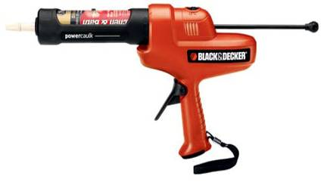
Tools - Power Caulking Guns
Reduce stress to fingers, hand, and forearm
Notes:
A powered caulking gun is one such tool that can eliminate a lot of the stress on the hand, fingers, and forearm
With a powered caulking gun, you won’t have to squeeze the trigger to apply the caulk or sealant.

Slide 39
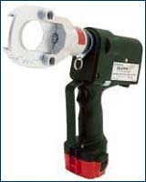
Tools - Battery Operated Cable Cutters
Powered cable cutters reduce the strain from using hand powered cutting tools
Notes:
Similarly, powered cable cutters greatly reduce the amount of force that must be applied by the hand.

Slide 40
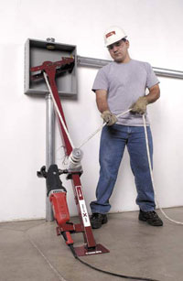
Tools - Mechanical Wire Pullers
Reduces the strain that would occur from pulling wire manually.
Notes:
Pulling wire manually puts a lot of stress on the back and shoulders. Mechanical wire pullers reduce a lot of this stress since the equipment does the pulling.

Slide 41
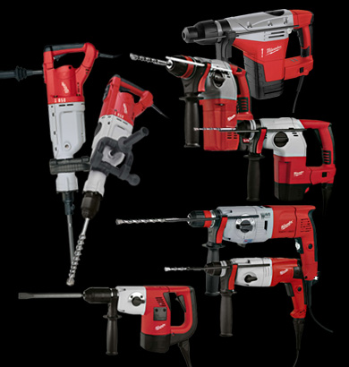
Tools - Low Vibration Tools
High Vibration Tools Can Damage Blood Vessels and Nerves in hand
Notes:
There are many tools available that have reduced vibration levels. High vibration can damage the blood vessels and nerves in the hand.

Slide 42
Additional Resources
Choosing Safer Hand Tools in Construction
http://www.lhsfna.org/files/handtools1.pdf
OSHA Ergonomics Page http://www.osha.gov/SLTC/ergonomics/index.html
Construction Ideas-Reducing Soft Tissue Injuries http://www.worksafebc.com/publications/health_and_safety/bulletins/constructive_ideas/default.asp
Ergonomic Survival Guide for Carpenters and Framers
http://www.dir.ca.gov/dosh/dosh_publications/erg_CarpFramer.html
Ergonomic Survival Guide for Electricians http://www.dir.ca.gov/dosh/dosh_publications/ElectriciansErgo.pdf
Ergonomic survival Guide for Laborers ttp://www.dir.ca.gov/dosh/dosh_publications/Erg_Laborer.pdf

Slide 43
Additional Resources
Simple Solutions: Ergonomics for Construction Workers
http://www.cdc.gov/niosh/docs/2007-122/
OSHA Ergonomics etool for Electricians http://www.osha.gov/SLTC/etools/electricalcontractors
www.lhsfna.org/ergonomicsandconstruction
Job Hazard Analysis, OSHA 3071

