Slide 1



A Tutorial on Establishing Effective Work Zone Performance Measures
Tracy Scriba,
Federal Highway Administration
and
Gerald Ullman,
Texas Transportation Institute

Slide 2

What is Work Zone
Performance Measurement?
Determining progress or level of attainment towards specific defined agency objectives regarding:
  Safety
  Mobility
  Customer satisfaction
  Agency/contractor efficiency and quality
Evidence based

Slide 3
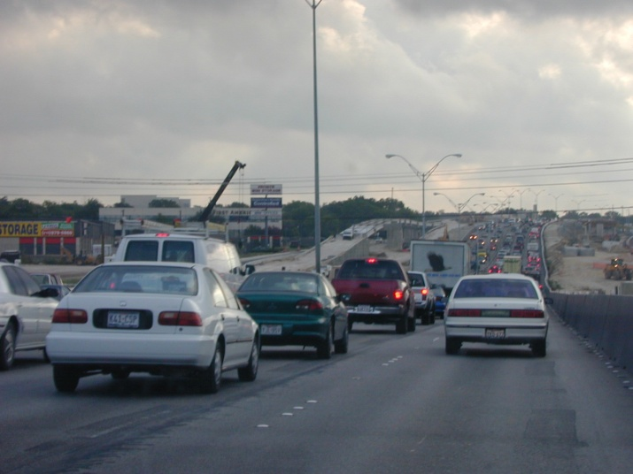
Why are Work Zone Performance Measures Important and Useful?
Quantifies work zone impacts
  Effects on motorists
  Actions taken to mitigate impacts
  Effects of actions taken

Slide 4

Why are Work Zone Performance Measures Important and Useful?
Guides investment decisions, policy development, and program priorities
  Identify trends
  Refine policies and procedures
  Emphasize accountability

Slide 5
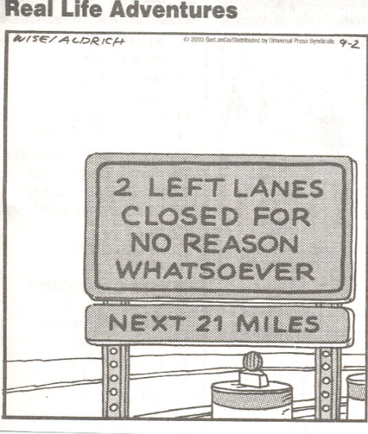
Why are Work Zone Performance Measures Important and Useful?
Assists in communication and outreach
  Aids agencies in “telling their story”
  Facilitates better public understanding and acceptance
  Ensures that elected officials have correct information

Slide 6


WZ Rule: WZ Data and PMs
Rule Goal: Better understand and manage WZ impacts
Related Provisions:
  Impacts Assessment
  Use of Data
  Process Reviews
Move practice forward
Notes:
The WZ Rule is built on better understanding and managing WZ safety and mobility impacts. This requires data and information.
Recognizing this, the WZ Safety and Mobility Rule includes provisions for impacts assessment, data, and process reviews. In updating this Rule, FHWA expanded the data provision to include operational data. Operational data – such as traffic volumes/exposure and queues – are critical to understanding both the safety and mobility impacts of WZs.
Having WZ performance measures can helps an agency focus in on an agreed upon set of key parameters so that data collection efforts can be done efficiently and data used effectively to make decisions.

Slide 7
WZ Rule Data Provisions
Requires agencies to use WZ data at both the project and process-levels to manage and improve work zone safety and mobility
  Project level: Improvements while projects are underway
  Process level: Broad improvements over time
Recommends that agencies maintain data and information resources to support the use of WZ data for the above activities

Slide 8
Work Zone Performance Nationally:
Work Zone Self Assessment
Done annually since 2003
10.3 average (0 to 15 scale)

Slide 9
Challenges in Measuring Work Zone Performance
Defining objectives that are:
  Acceptable
  Realistic
  Useful
Identifying and obtaining useful data
Allocating sufficient resources (staff and money)

Slide 10
Work Zone Performance Measurement Myths
“Measurements must be obtained for all work zones”
  Reality: It may be only necessary to monitor a set of key work zones
“Measurements must be continuous at the work zones that are monitored”
  Reality: It may only be necessary to obtain a few key measurements during the right times and at the right locations in a work zone

Slide 11
Work Zone Performance Measurement Myths
“A lot of time and money must be spent on data collection”
  Reality: Depending on project characteristics, low-cost data collection methods may be available and appropriate

Slide 12
Work Zone Performance Measurement Myths
“A lot of time and money must be spent on data collection”
  Reality: depending on project characteristics and agency goals, low-cost data collection methods may be available and appropriate
Work zone performance measurement is simply a tool that can help an agency accomplish its mission more effectively

Slide 13
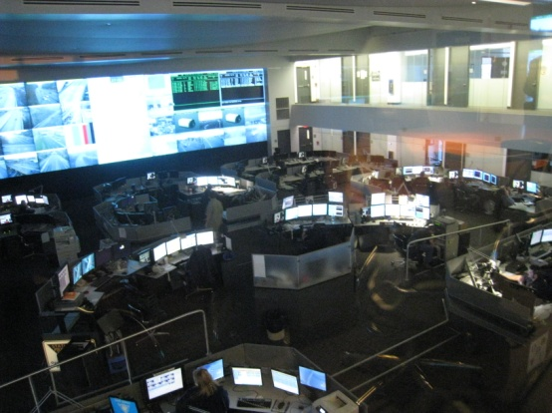

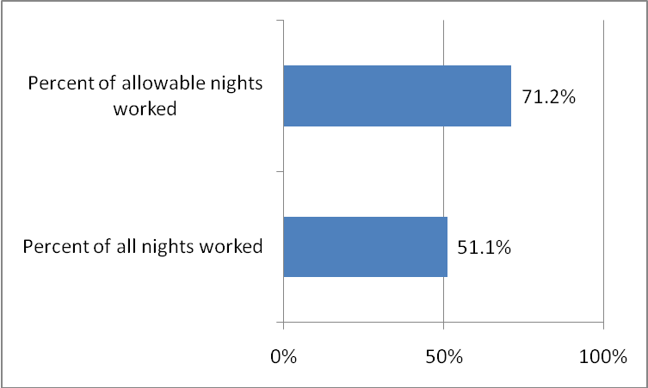
Making Work Zone Performance Measurement Happen in your Agency

Slide 14
Key Steps
Identify and engage stakeholders
Select appropriate measures
Identify available data sources
Define analysis requirements
Assign roles and responsibilities
Define methods for disseminating results
Periodically review and refine measures

Slide 15

1. Identify and Engage Stakeholders to Define:
Needs for performance measures
Performance goals or targets (based on policy and procedures)
Performance measurement “champions”

Slide 16
2. Select the Measures
Base on the performance goals or targets identified
Keep to a manageable number
Consider data needs
Start simple, refine and expand as needs and uses dictate

Slide 17
Measures to consider
Exposure
  Vehicle exposure
  Work activity exposure
Safety
  Crashes or accidents
  Safety surrogates
Mobility
  Queues
  Travel times or delays
  Travel time reliability
  Agency ratings
  Customer complaints or ratings
Notes:
% days or night when work activity occurs
Average hours of work per day or night
% work hours with lane closures
Lane-mile-hour of closures (overall, during certain time periods)
Counts (possibly by severity)
% of crashes of a certain type
Rates per vehicle-mile-traveled (or change in rate)
% of projects that exceed an acceptable crash rate (or change in rate)
$ or % change in crash costs compared to the expected no-work-zone costs
Highway worker injuries or rate per hours worked

Slide 18
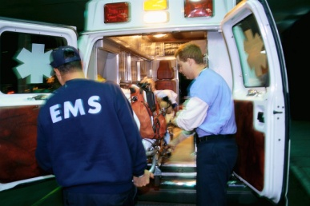
3. Identify Data Needs and Sources
Exposure data
  Project plans
  Agency construction management database
  Inspector diaries
  Lane closure request databases
  Automatic traffic recorder (ATR) counts
  Planning division AADT estimates
  Manual counts
  Real-time electronic traffic surveillance data
Safety data
  Statewide crash database
  Agency collected work zone crash data
  Occupational safety records
  Agency field reviews
  Service patrol or EMS dispatch logs

Slide 19


3. Identify Data Sources (cont’d)
Mobility data
  Electronic traffic surveillance technologies
  Observations and documentation of queues by field personnel or transportation management center operations staff
  Travel time runs by staff or interns
  Agency inspection scores
  Customer survey responses
  Customer complaint files

Slide 20
Electronic Traffic Surveillance Sources
Point measurements of speed, volume
  Existing transportation management system spot sensors
  Work zone ITS deployments
  Portable traffic monitoring devices
Point-to-point travel times
  Automatic vehicle location, identification systems
  License-plate recognition systems
  Cellular telephone signal tracking
  Bluetooth
  Purchase of private-sector data

Slide 21
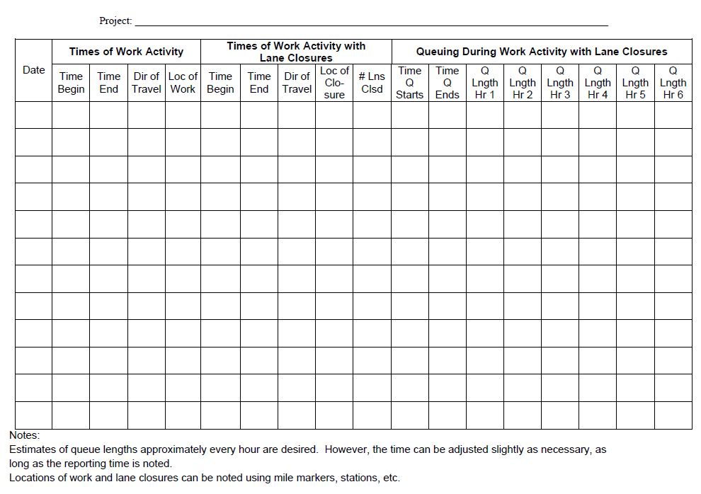
Manual Documentation of Queues

Slide 22
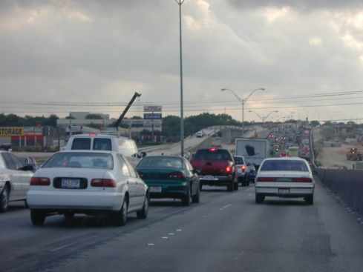

4. Define Analysis Requirements
Estimating travel times and delays from queue length documentation
Estimating queue lengths from spot sensor data

Slide 23
Travel Times from Queue Lengths
Notes:
  Appropriate only if pre-work zone conditions do not experience queues
  Other speed/density/flow relationships could be assumed

Slide 24
Queues from Spot Speed Sensors
Steps:
  Divide roadway into segments of uniform speed
  Examine speeds and volumes hour-by-hour
  Compare speeds across sensors
  Sum regions where speeds are below thresholds
  Compute individual and vehicle-hours of delay

Slide 25

5. Assign Roles and Responsibilities
Data collection
Analysis
Decision-making
Dissemination

Slide 26
6. Define Methods for Disseminating Results
Consider key users
  Technical managers and decision makers
  Public and political leaders
Tailor messages to each user group as appropriate

Slide 27
7. Review and Refine Measures
Key questions:
  Do measures aid in evaluating progress?
  Do measures point to changes that may be needed in policies or procedures?

Slide 28

Work Zone Performance Measurement – Getting Started

Slide 29
One Example…
An agency currently reviews its total fatal work zone crashes each year

Slide 30
The Agency Selects a Measure:
Change in severe (injury + fatal) crash rates from pre-work zone conditions
  Initial focus will be on freeway work zones
  Each of 4 districts to evaluate two of its work zones annually

Slide 31
Results
District | Severe Crash Rate Before | Severe Crash Rate After | Change
1 | 2.7/100 mvm 4.6/ 100 mvm | 3.5/100 mvm 4.3/100 mvm | +30% -7%
2 | 1.2/100 mvm 1.5/100 mvm | 1.3/100 mvm 2.5/100 mvm | +8% +67%
3 | 1.7/100 mvm 0.9/100 mvm | 2.4/100 mvm 1.9/100 mvm | +41% +111%
4 | 3.1/100 mvm 1.6/100 mvm | 3.0/100 mvm 2.1/100 mvm | -3% +31%
Observations made by the agency
  Rates do trend higher
  Increases are highly variable
Agency performs detailed analysis of projects
  Project durations and volumes vary widely
  Identifies some good practices, issues to address

Slide 32
They also modify their analysis methodology…
Crash Analysis Results the Following Year
District | Severe Crashes Expectedª | Severe Crashes That Occurred | Difference
1 | 3.6 19.1 | 5 26 | +1.4 +6.9
2 | 1.1 10.4 | 0 12 | -1.1 +1.6
3 | 35.4 4.9 | 48 3 | +12.6 -1.9
4 | 26.6 3.2 | 40 4 | +13.4 +0.8
Overall | 104.3 | 138 | +33.7 (+32%)
ª Expected crashes computed using Highway Safety Manual approach

Slide 33
Another Example…
An agency has adopted a policy that no work zones will create more than a 15-minute delay for motorists
  9 complaints per month from motorists
  Are delays occurring, and are they greater than 15 minutes?
Institute procedures for inspectors to document all queues that occur and estimate delays

Slide 34
Results (out of 31 projects)
Inspector | Queues | Per Vehicle Delay | Total Delay
1 | 5 days Length: Ave = 0.4 miles, Max = 3.1 mi Duration: Ave = 2.1 hrs, Max = 4 hrs | Ave = 7.6 min Max = 58.9 min | 2394 veh-hrs
2 | 1 day Length: ave = 1.4 miles, max = 1.8 mi Duration: 1.5 hrs | Ave = 2.0 min Max = 2.8 min | 75 veh-hrs
3 | 15 days Length: Ave = 0.8 miles, max = 1.2 mi Duration: Ave = 1.5 hrs, Max = 2.0 hrs | Ave = 1.4 min Max = 2.1 min | 840 veh-hrs

Slide 35
Observations
Impacts being observed at a small (< 10 %) number of projects
Unclear how many motorists are being excessively delayed
Adjust monitoring to determine % of vehicles experiencing greater than 15 minutes of delay

Slide 36
Recomputed Results …
Inspector | Queues (Speeds < 35 mph) | Per Vehicle Delay | % Vehicles with > 15 min Delay | Total Delay
1 | 5 days Length: Ave = 1.4 mi Max = 3.1 mi Duration: Ave = 2.1 hrs Max = 4 hrs | Ave = 7.6 min Max = 58.9 min | 1.2 % of total ADT 15.1 % of queued vehicles | 2394 veh-hrs
Next steps taken:
  Interns are hired to assist in traffic monitoring (requested by project engineers)
  Requirement to document queues is extended to the maintenance section
  Percent of projects that exceed agency delay threshold is added to dashboard metrics on agency website

Slide 37
A Final Example
The director of an agency assigns the traffic operations division to establish a work zone performance measurement program…

Slide 38
1. Identify and Engage Stakeholders
Key agency staff
  Division staff
  District engineers
  Public information office
  Project design division
Performance targets
  Vehicle delays < 15 min
  85% of users who encounter a delay warned in advance
  Crashes no more than 20% greater than expected without a work zone present

Slide 39
2. Select Appropriate Measures
Individual vehicle delays during hours of delay
Percent of customers indicating awareness of when and where delays were going to occur
Ratio of actual severe crashes to expected crashes

Slide 40
3. Identify Data Sources
Project designers:
  identify any projects with peak-hour volume-to-capacity > than 0.9
Interns:
  conduct peak-hour travel time studies at projects after each phase change
Inspectors:
  document queues during any short-term lane closures in Districts

Slide 41
3. Identify Data Sources (cont’d)
University:
  conduct annual survey of customer opinions about work zones
Statewide crash database to be used to evaluate 5 high-volume projects annually

Slide 42
4. Define Analysis Requirements
Interns to gather and analyze project inspector data on queues monthly
Interns compute delays based on queue data
Safety division to provide expected crash frequencies at selected project locations (based on Highway Safety Manual procedures)
University – customer survey analysis

Slide 43
5. Assign Roles and Responsibilities
Division staff
  Hiring and supervising interns
  Coordinating information collection and analysis on key projects
  Assessing implications of measures on agency policies and operations
District engineers
  Issue requirement regarding project inspector documentation of queues

Slide 44
5. Roles and Responsibilities (cont’d)
Project design division staff
  Identify key projects
Safety division staff
  Develop baseline crash frequencies
Public information office
  Creation of summary document for director
  Posting results on agency website (dashboard)

Slide 45
6. Define Methods for Disseminating Results
Executive summary document
  Director, public officials
Dashboard summary on website
  General public
Presentation of results at annual short course

Slide 46
7. Periodically Review and Refine Measures
Revisit every two years as part of process assessment
Stakeholders to meet to discuss need to expand or contract effort, identify additional information needs or issues to be examined

Slide 47
Resources
A Primer on Work Zone Safety and Mobility Performance Measurement
Work Zone Performance Measures Pilot Test
Domestic Scan on Work Zone Assessment, Data Collection, and Performance Measurement
Available at http://www.ops.fhwa.dot.gov/wz/decision_support/performance-development.htm

Slide 48
Questions?
Tracy Scriba, FHWA
(202) 366-0855
Tracy.Scriba@dot.gov
Gerald Ullman, TTI
(979) 845-9908
g-ullman@tamu.edu

