Slide 1
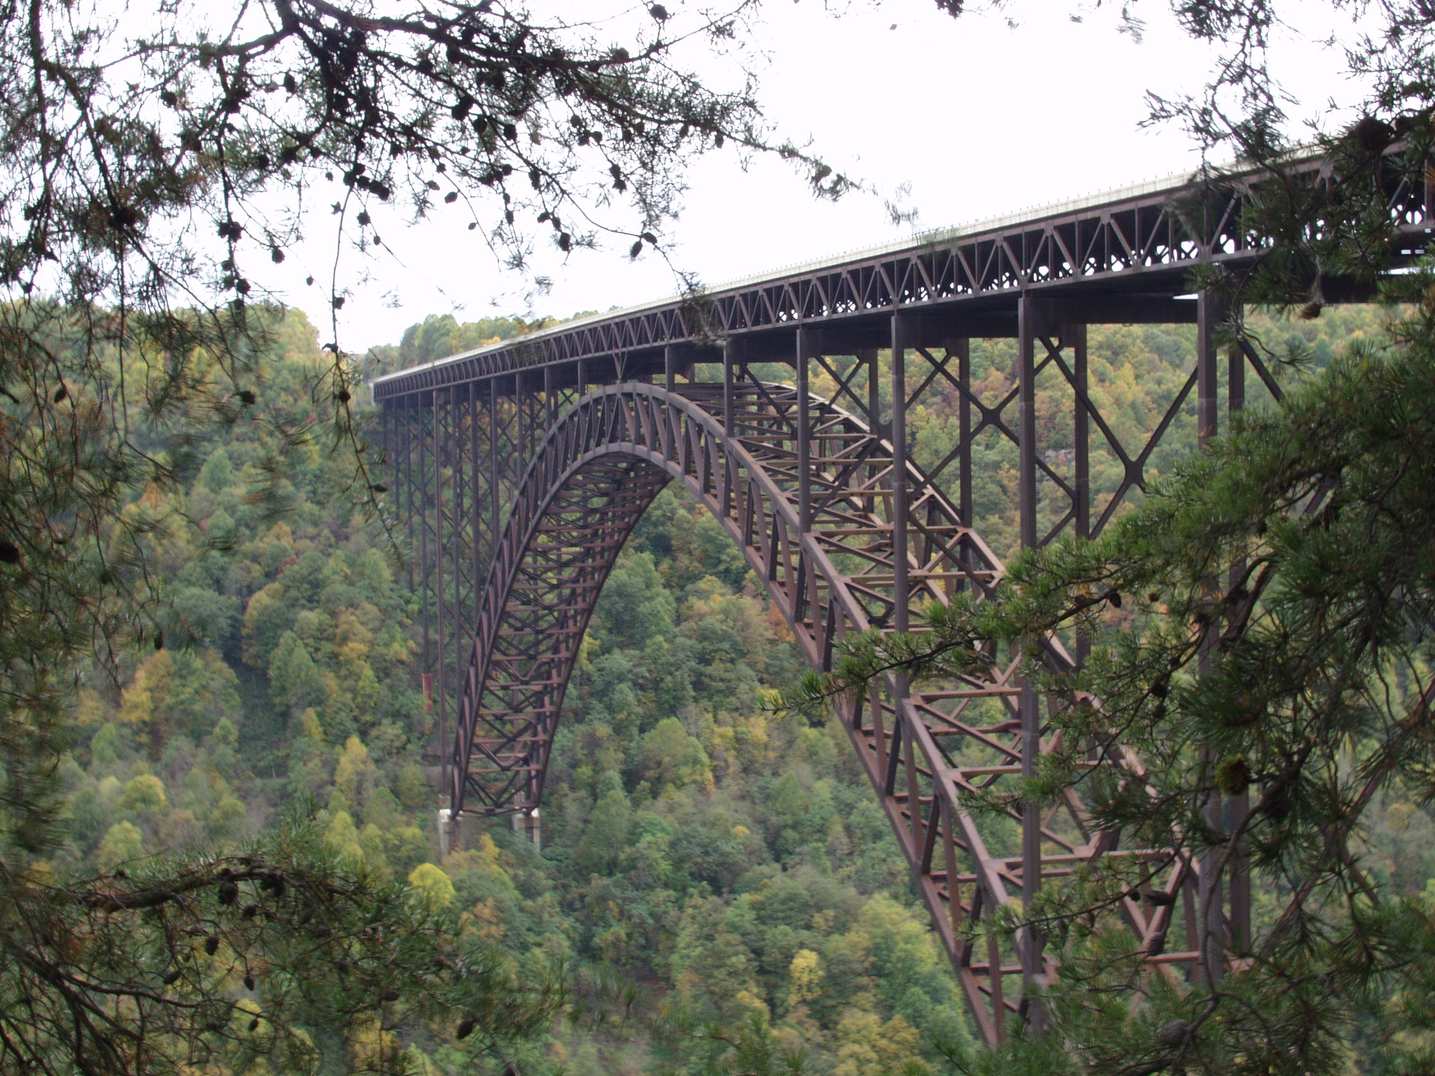
Injury Hazards in Road and Bridge Construction
Jennifer E. Lincoln
David E. Fosbroke
International Bridge Conference
Pittsburgh, PA
June 8, 2010

Slide 2
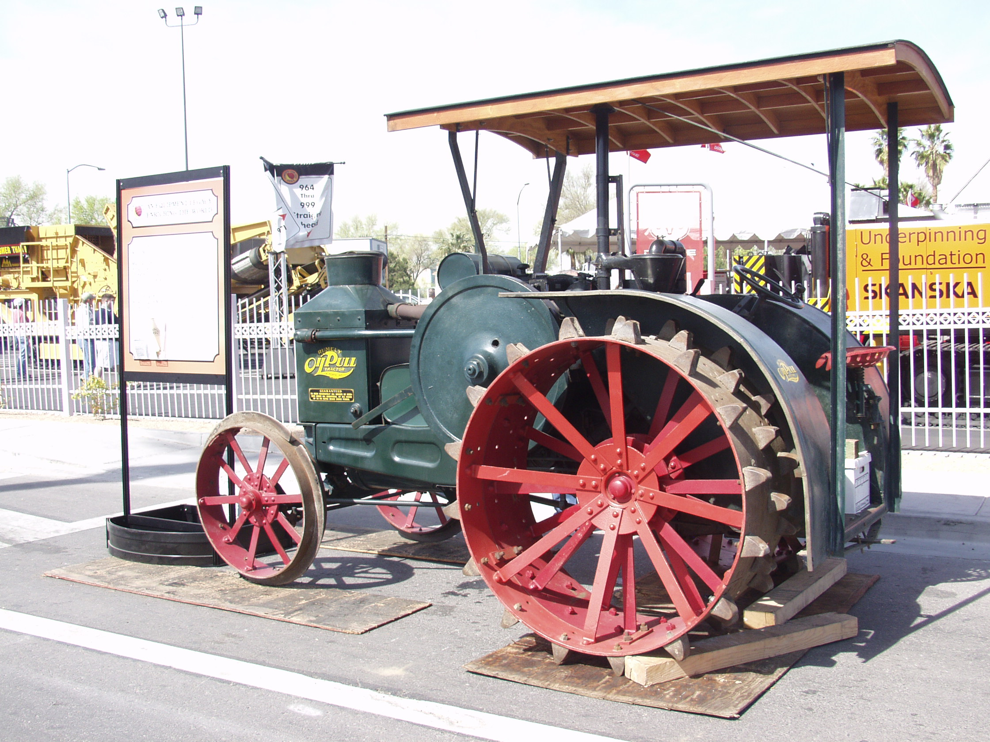
Background
Road and Bridge Construction Facts
  Citations, Nonfatal Injuries and Illnesses, Fatal Injuries
Safely Working Around Trucks and Equipment
  Blind Areas, Proximity Warning, Internal Traffic Control
Road and Bridge Construction Hazards
  Separating Workers from Traffic, Safe Entry and Exit
Injury Hazards in Road and Bridge Construction
Injury Hazards in Road and Bridge Construction

Slide 3
Public Law 91-596
Public Law 91-596
Public Law 91-596
Public Law 91-596
91st Congress, S. 2193
91st Congress, S. 2193
91st Congress, S. 2193
91st Congress, S. 2193
December 29, 1970
December 29, 1970
December 29, 1970
December 29, 1970
An Act
An Act
An Act
An Act
To assure safe and healthful working conditions for working
To assure safe and healthful working conditions for working
To assure safe and healthful working conditions for working
To assure safe and healthful working conditions for working
men and women: by authorizing enforcement of the standards
men and women: by authorizing enforcement of the standards
men and women: by authorizing enforcement of the standards
men and women: by authorizing enforcement of the standards
developed under the Act: by assisting and encouraging
developed under the Act: by assisting and encouraging
developed under the Act: by assisting and encouraging
developed under the Act: by assisting and encouraging
the States in their efforts to assure safe and healthful
the States in their efforts to assure safe and healthful
the States in their efforts to assure safe and healthful
the States in their efforts to assure safe and healthful
working conditions: by providing for research, information,
working conditions: by providing for research, information,
working conditions: by providing for research, information,
working conditions: by providing for research, information,
education, and training in the field of occupational safety
education, and training in the field of occupational safety
education, and training in the field of occupational safety
education, and training in the field of occupational safety
and health: and for other purposes.
and health: and for other purposes.
and health: and for other purposes.
and health: and for other purposes.
Be it enacted by the Senate and House of Representatives
Be it enacted by the Senate and House of Representatives

Slide 4
NIOSH Role in the U.S. Occupational Safety and Health Framework
Regulation/Enforcement
Research and
Prevention Recommendations
Department of Labor
(DOL)
Department of
Health and Human Services
(HHS)
Centers for Disease
Control and Prevention
(CDC)
Mine Safety
and Health
Administration
(MSHA)
Occupational
Safety and Health
Administration
(OSHA)
National Institute for
Occupational Safety
and Health (NIOSH)

Slide 5

The National Institute for Occupational Safety and Health
The federal agency responsible for conducting research and making recommendations for the prevention of work-related injury and illness.

Slide 6
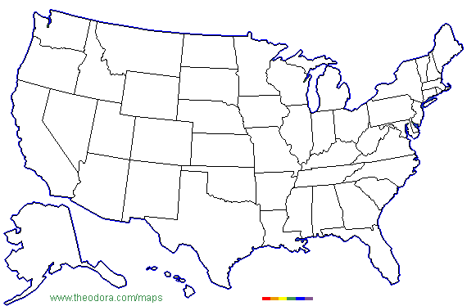
NIOSH Locations
NIOSH Staff: ~1,200

Slide 7
NIOSH Construction Research Program
Construction Program Mission
“Provide national and world leadership to prevent
work-related illness, injury, disability, and death by
systematically gathering information, conducting
targeted scientific research, and translating the
knowledge gained into products, solutions, and
services tailored to meet construction needs”
Notes:
My hunch is that you know OSHA very well. Compliance is a basic issue. You interact with OSHA on your jobsites. OSHA has offices in your home area.
But NIOSH may be a little more mysterious to you. So lets cover some key points.
Our mission….

Slide 8
NIOSH Construction Program
Intramural
Research
Basic Research
Surveillance
Methods Research
Exposure Assessment
Controls development
Applied Research
Research to Practice
National
Construction
Center
Industry Characterization
Applied Research
Industry Liaison
Intervention
Research to Practice
Extramural
Investigator
Initiated grants
Innovative ideas
Opportunities
State Initiatives
CPWR
Center for Construction Research and Training

Slide 9
NIOSH Construction Program
Intramural
Research
National
Construction
Center
Extramural
Investigator
Initiated Grants
CPWR
Center for Construction Research and Training

Slide 10
General
Construction
NIOSH Publication No.
2009-118:
A Compilation of NIOSH Construction Publications and Other Informational Resources, 1977-2008
This CD ROM is intended to
provide quick and easy computer
access to a large number of NIOSH
publications related to construction.

Slide 11


NIOSH Construction
Program Review
Performed by a National Academies Committee
Focused on work done over last 10 years
Provided recommendations for
improving the program
Received score of 5/5 for RELEVANCE
Received score of 4/5 for IMPACT
Report available at:
http://www.cdc.niosh/nas/
Notes:
The NIOSH program was recently reviewed and we are pleased to say that we matched the highest score received by only one other NIOSH program ---8 have been reviewed.
The report is available at ….
These results also go to OMB and others as part of a national effort to review government programs
When President Obama mentions in a speech that its “Not whether government is too big or too small but whether it works” ---and that “when the answer is yes – we will move forward – and when the answer is no – programs will end” it is this type of program review that he is talking about

Slide 12
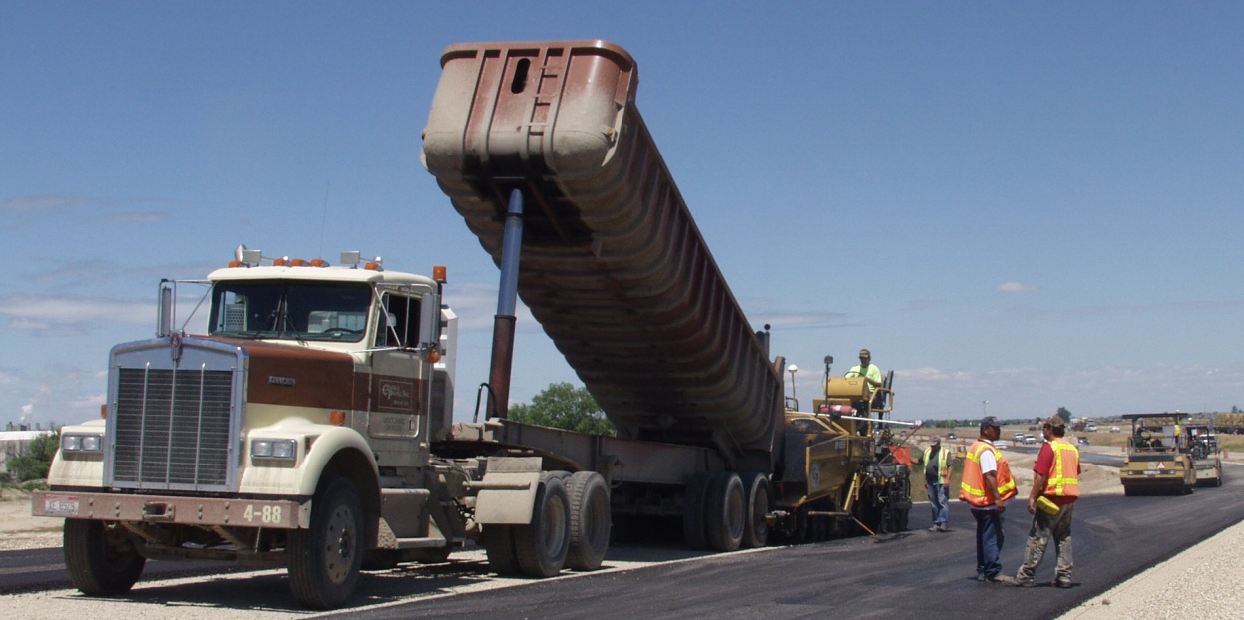
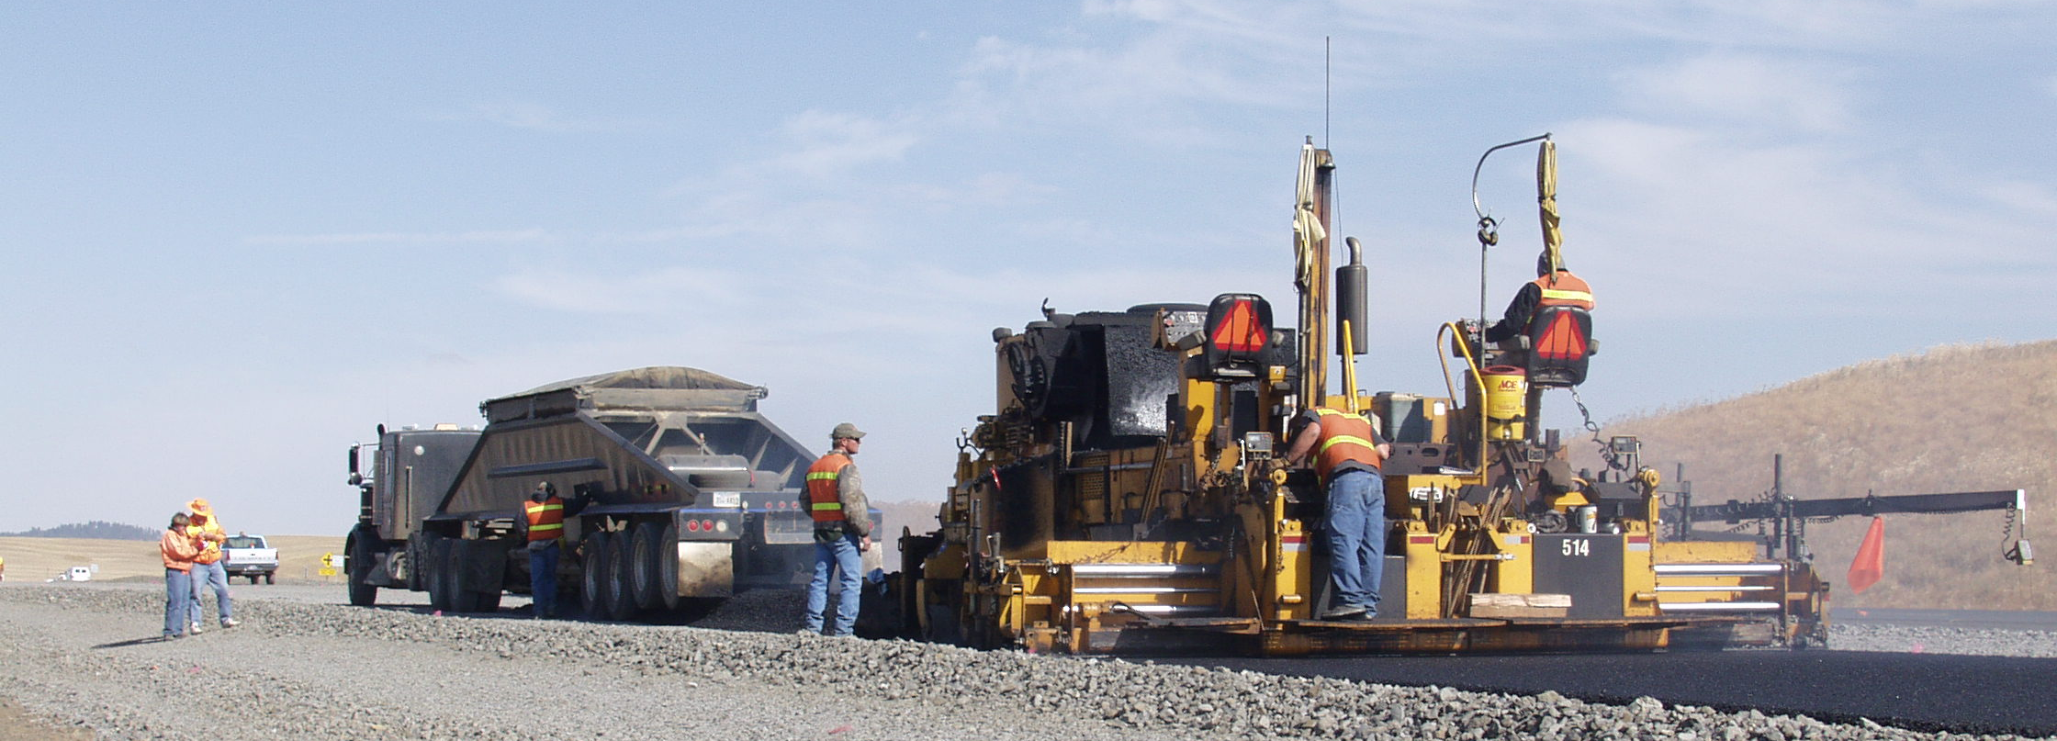
Evaluating Roadway Work
Zone Interventions
A Research Project Conducted by the
National Institute for
Occupational Safety and Health

Slide 13
Site Visit
Pilot Site
Experimental Site

Slide 14
State Transportation Departments
Construction Companies
Engineering Consultants
Labor Unions
Construction Trade Associations
Equipment Manufacturers
FHWA, OSHA
Notes:
The NIOSH work zone safety research project was conducted with the participation of our colleagues in Spokane, Washington and Pittsburgh, Pennsylvania. However, all of us at NIOSH are deeply indebted to the people who gave us the privilege of sharing time with them at construction projects around the country. It is the companies, labor unions, and workers at each of our study sites and our industry partner associations, agencies, and labor union safety organizations that are the reason that we have information to share with you today.

Slide 15







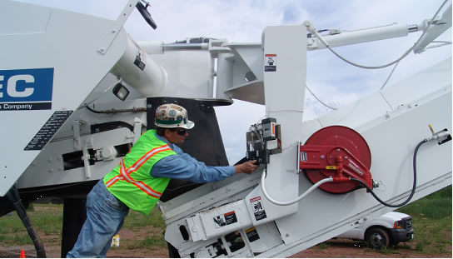

Work Zone
Safety and Health Partners
Notes:
Here are a couple of examples of NIOSH research partnerships
This one involves asphalt milling, which is the operation that removes the top level of pavement prior to paving
NIOSH brings engineering expertise on how to design and place spray nozzles for reducing dust. We involved engineers from our mining program who had experience from continuous mining machines.
The partners, who included the five biggest manufacturers
So how can you get real world construction conditions AND also minimize uncontrolled variables for research measurements? The Chair for the Silica/Milling-Machines Partnership effort, Tony Bodway, of Wisconsin-based highway-construction contractor Payne & Dolan, Inc., was instrumental in finding a solution. He secured an abandoned airport in Marquette, Michigan, where milling demonstrations could be done on the main runway. This location proved ideal: no traffic and a highly controlled test environment. The resulting June 2008 testing was dubbed “Mill Fest '08.” Each machine was tested for comparison of the dust-suppression performance of several water-spray configurations (including the current production design), and at lest seven replicate test trials were conducted using each configuration. Preliminary feedback from this first set of demonstrations was presented to NAPA's membership at its midyear meeting. Results from real-time, data-logging dust monitors suggest that one water-spray configuration for each of the two machines may be superior to the others tested.

Slide 16
Acknowledgements (continued)
James E. Bryden
Steve Hubbard
Michael Grey
Michael Paylor
Marv Sahlo
Notes:
I am not bashful about stealing good safety information from people who are smarter than me. So I would like to acknowledge that some material that we will present is adapted from presentations by James Bryden, formerly of the NYS DOT; Steve Hubbard and Michelle Grey of Lane Construction Corporation; Michael Paylor of the Maryland State Highway Administration, and Marv Sahlo of the Minnesota DOT.

Slide 17
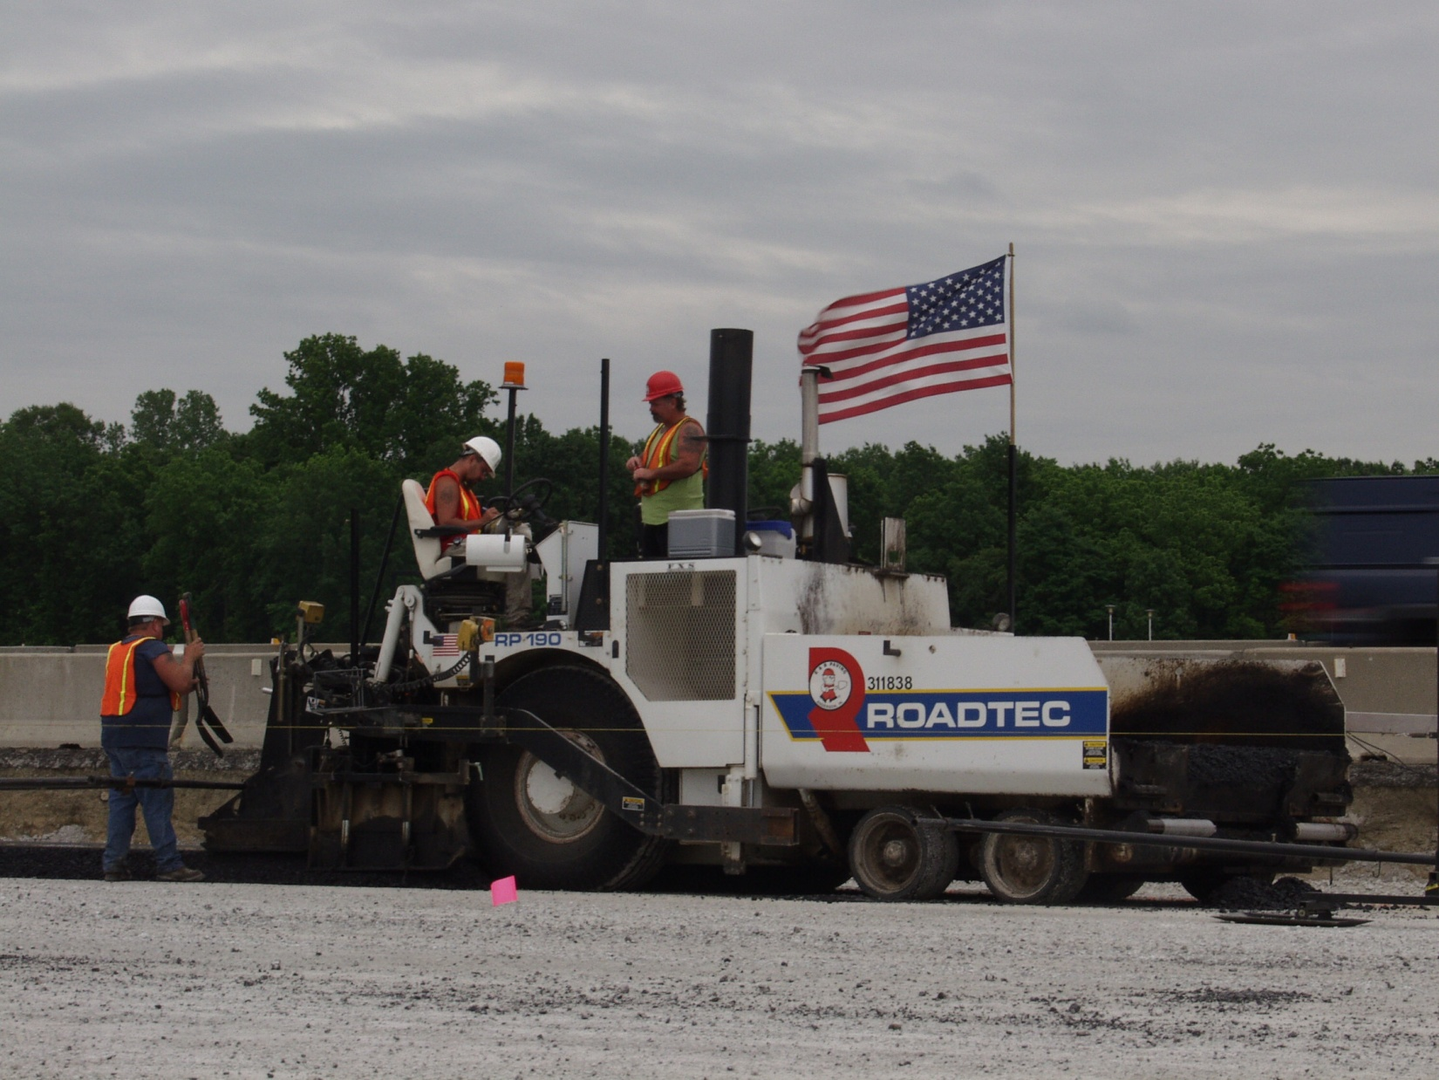
  The findings and conclusions in this presentation have not been formally disseminated by the National Institute for Occupational Safety and Health and should not be construed to represent any agency determination or policy.

Slide 18
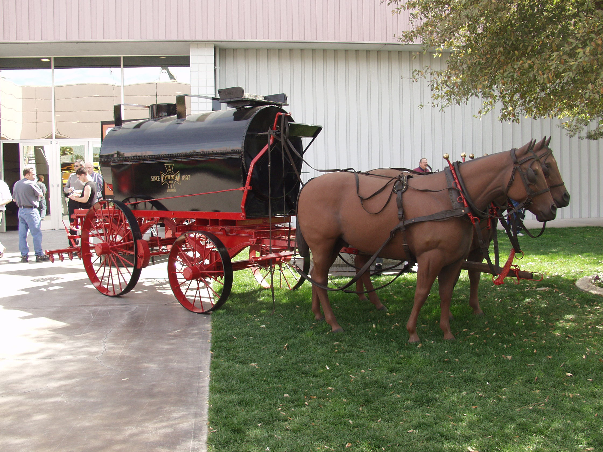
The mention of any company name or product does not constitute endorsement by the National Institute for Occupational Safety and Health.
The photographic display of any product, label, or logo does not constitute endorsement by the National Institute for Occupational Safety and Health.

Slide 19
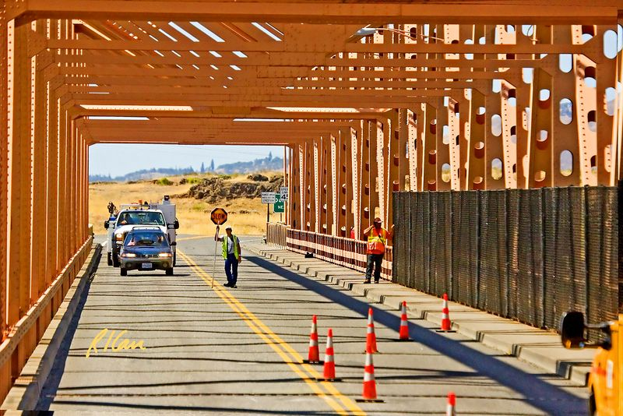
Road & bridge construction Facts

Slide 20
U.S. Infrastructure (2008)
Road System Miles
  Urban ~1.1 trillion
  Rural ~ 3.0 trillion
  Total ~ 4 trillion
Bridges
  Urban 153,407
  Rural 447,989
  Total 601,396
Source: U.S. Department of Transportation Statistics Highway Profile
Notes:
Road System Miles
Urban 1,065,556 million
Rural 2,977,222 million
Total 4,042,778 million
Bridges
Urban 153,407
Rural 447,989
Total 601,396

Slide 21
U.S. Infrastructure Condition (2008)
Roads
  65% paved
Bridges
  75% good repair
  12% deficient
  13% obsolete
Source: U.S. Department of Transportation Statistics Highway Profile
Notes:
Bridges
71,461 deficient
79,993 obsolete
449,942

Slide 22
Government Highway System Expenditures
37%
61%
2%
Source: U.S. Department of Transportation Statistics Highway Profile
Notes:
Federal State/D.C. Local
2003 2383 88377 53047
2004 3407
88026 55993
2005 1902 94484 56313
2006 2191 100090 58780
2007 2256 105013 64484

Slide 23



The American Recovery and Reinvestment Act of 2009 (ARRA)
More than 12,600 projects obligated
More than 10,000 projects under construction
More than 2,200 projects completed
Total obligated funds for 50 states and the District of Columbia: $26.6 billion
Source: U.S. Department of Transportation ARRA Website, June 1, 2010

Slide 24
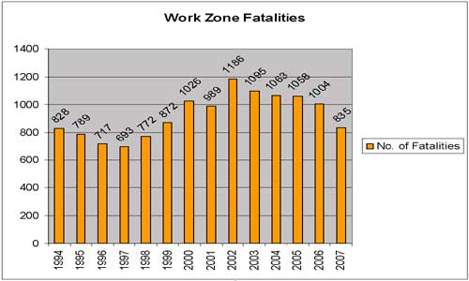
Source: http://www.fhwa.dot.gov/economicrecovery/workzones.htm
Notes:
Note: In 2008 the number was 720

Slide 25
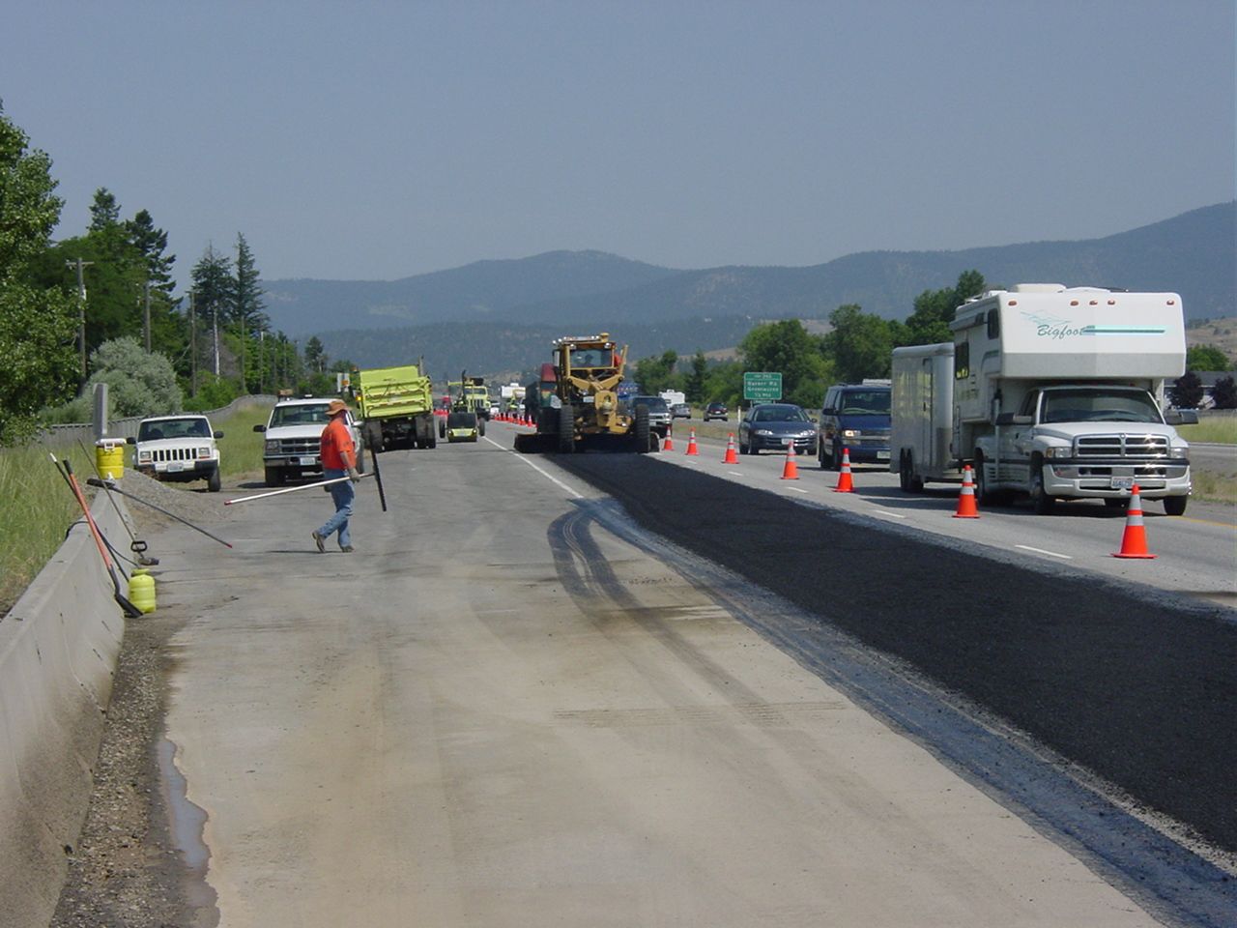
Data
Summary
Highway, Street, and Bridge Construction:
  Average of 139 deaths per year
  Being struck by vehicles and equipment continues as the leading cause of death
  80% of vehicle-related deaths involve trucks and construction equipment

Slide 26
Top 5 OSHA Citations
10/08-09/09
Bridge, Tunnel, and Elevated Highway Construction | Highway and Street Construction
Fall Protection (50) | Hazard Communication (60)
Cranes (43) | Excavation (60)
General (34) | Respiratory (45)
Lead (26) | Protective Systems (36)
Working /Over Near Water (23) | Signs and Tags (28)

Slide 27
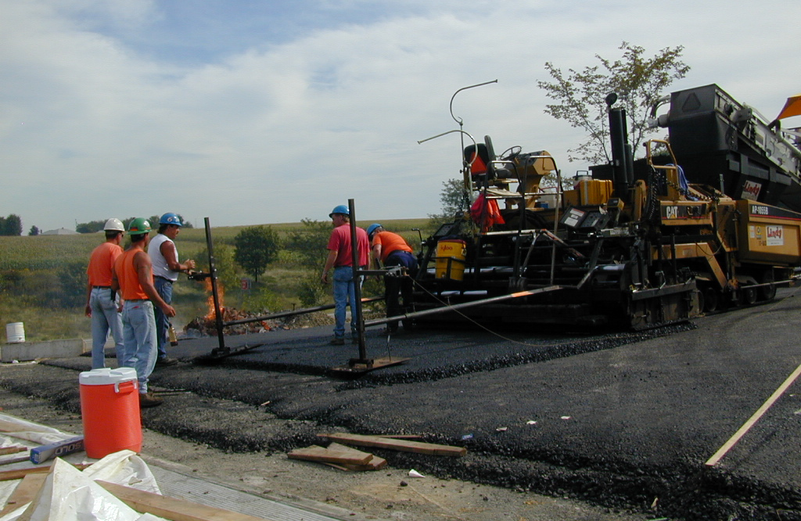
INJURIES AND ILLNESSES IN
ROAD & BRIDGE CONSTRUCTION

Slide 29
(2.4)
(2.0)
Source: Census of Fatal Occupational Injuries www.bls.gov/iif

Slide 30
Heavy & Civil Engineering Construction
Injuries in 2008
1,230
40,700
???????????????
21,900
DAFW due to Transportation
DAFW
Total Cases
Close Calls
Notes:
????? Close calls
40,700 Total Cases
21,900 Cases with days away, work restriction, or job transfer
1,230 Days away from work cases from transportation
880 Days away from work cases from pedestiran struck by vehicle or equipment in the construction industy

Slide 31
(1.5)
(1.8)
Source: Census of Fatal Occupational Injuries www.bls.gov/iif

Slide 32
Injuries and Illnesses by Occupation in
Highway Street and Bridge Construction (n=5,690)
Source: Census of Fatal Occupational Injuries www.bls.gov/iif

Slide 33
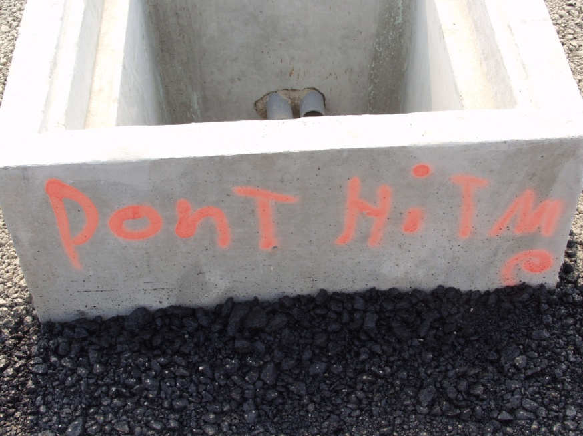
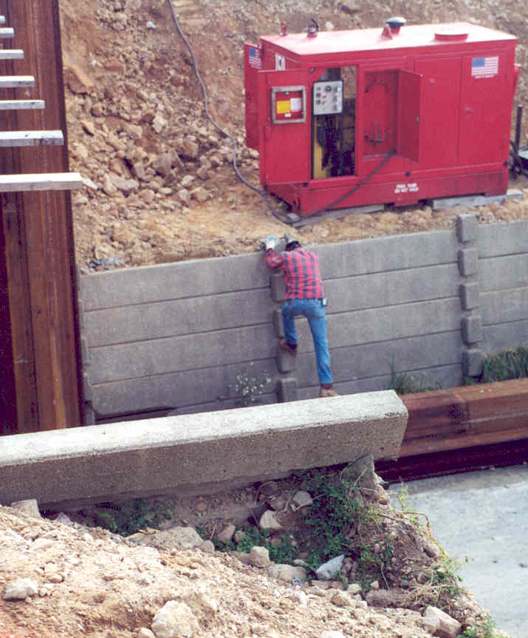
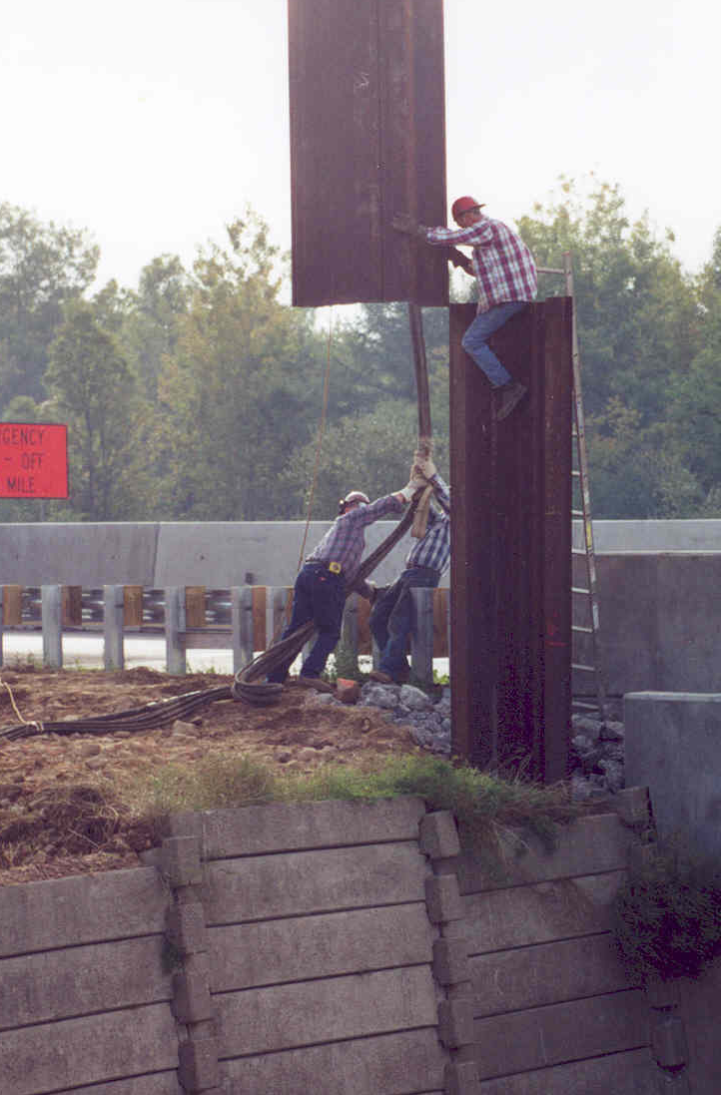
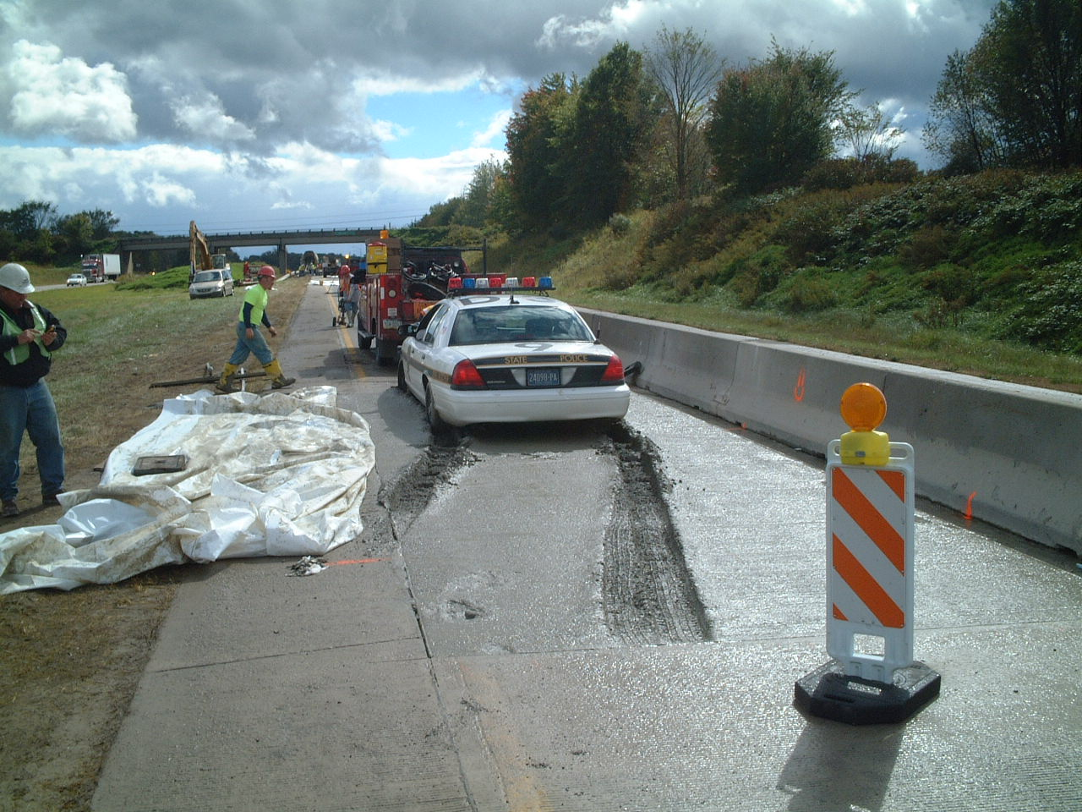
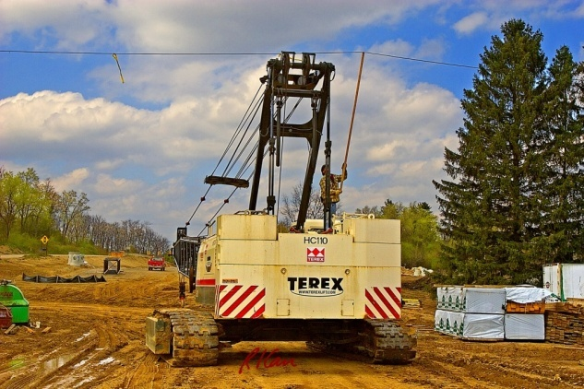
Highway Street and Bridge Construction
Days Away From Work Injuries and Illnesses by Event
2003-2008 (n=42,790)
Contact with Objects or equipment 35%
Slips, Trips, or Falls 20%
Overexertion 15%
Exposure to Harmful Substances or Environments 5%
Transportation Incidents 12%

Slide 34
Source: Census of Fatal Occupational Injuries www.bls.gov/iif

Slide 35
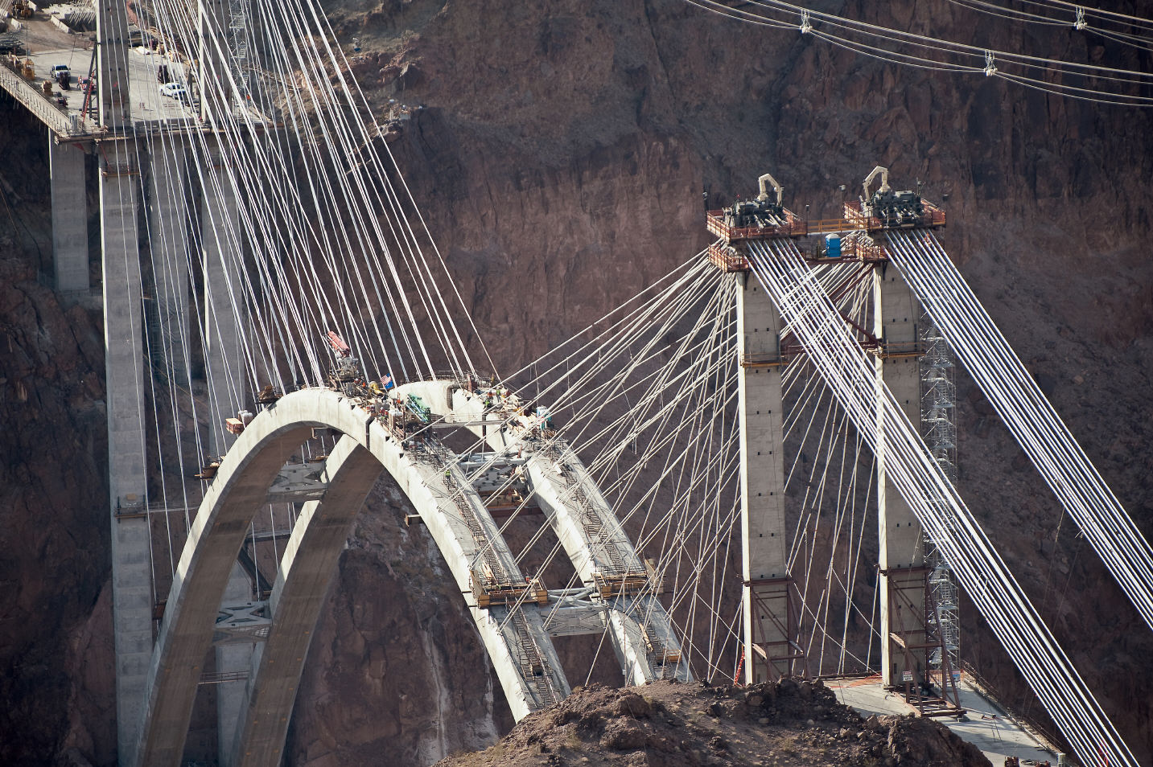
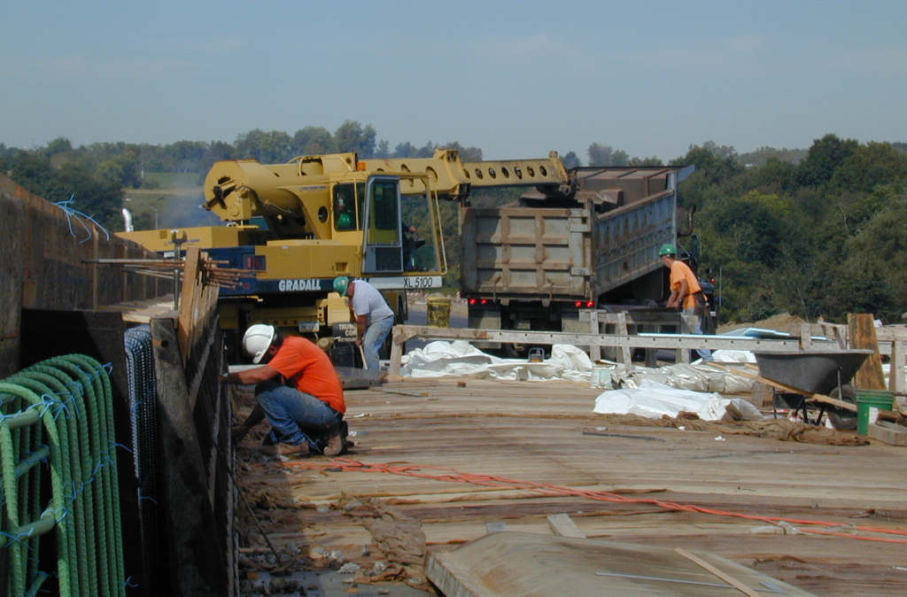
FATAL INJURIES IN
ROAD & BRIDGE CONSTRUCTION

Slide 37
Fatal Injuries in the United States in 2008
5,214
1,016
119
43
Occupational Fatalities
Construction Fatalities
Highway, Street, and Bridge Fatalities
Worker Struck by Vehicle in Highway, Street, and Bridge
Notes:
Highway Fatalities 37,261
Occupational Fatalities 5,214
Construction Occupational Fatalities 1016
Highway Street and Bridge Construction Fatalities 119
Highway Street and Bridge Construction Fatalities Event=Worker Struck by Vehicle 43

Slide 38
Worker Deaths in Roadway Construction
Trend from 1992-2000 (n=910)
Source: Census of Fatal Occupational Injuries. This research was conducted with restricted access to Bureau of Labor Statistics (BLS) data (excluding New York City). The views expressed here do not necessarily reflect the views of the BLS.

Slide 39
Worker Deaths in Highway, Street, and Bridge Construction
Trend from 2003 - 2008 (n=833)
Source: Census of Fatal Occupational Injuries www.bls.gov/iif

Slide 40


Highway Street and Bridge Construction
Fatalities by Event 2003-2008 (n=833)
Transportation Accidents 70%
Contact with Objects or equipment 18%
Exposure to Harmful Substances or Environments 4%
Slips, Trips, or Falls 4%

Slide 41
Worker Deaths in Highway, Street, and Bridge Construction
Deaths by Event Type, 2003 - 2008 (n=833)
37%
23%
10%
6%
Source: Census of Fatal Occupational Injuries www.bls.gov/iif

Slide 42
Worker Deaths in Highway, Street, and Bridge Construction
Deaths by Source Group, 2003 - 2008 (n=833)
57%
Source: Census of Fatal Occupational Injuries www.bls.gov/iif

Slide 43
Worker Deaths in Highway, Street, and Bridge Construction
Deaths by Vehicle Type, 2003 - 2008 (n=617)
58%
22%
13%
Source: Census of Fatal Occupational Injuries www.bls.gov/iif

Slide 44
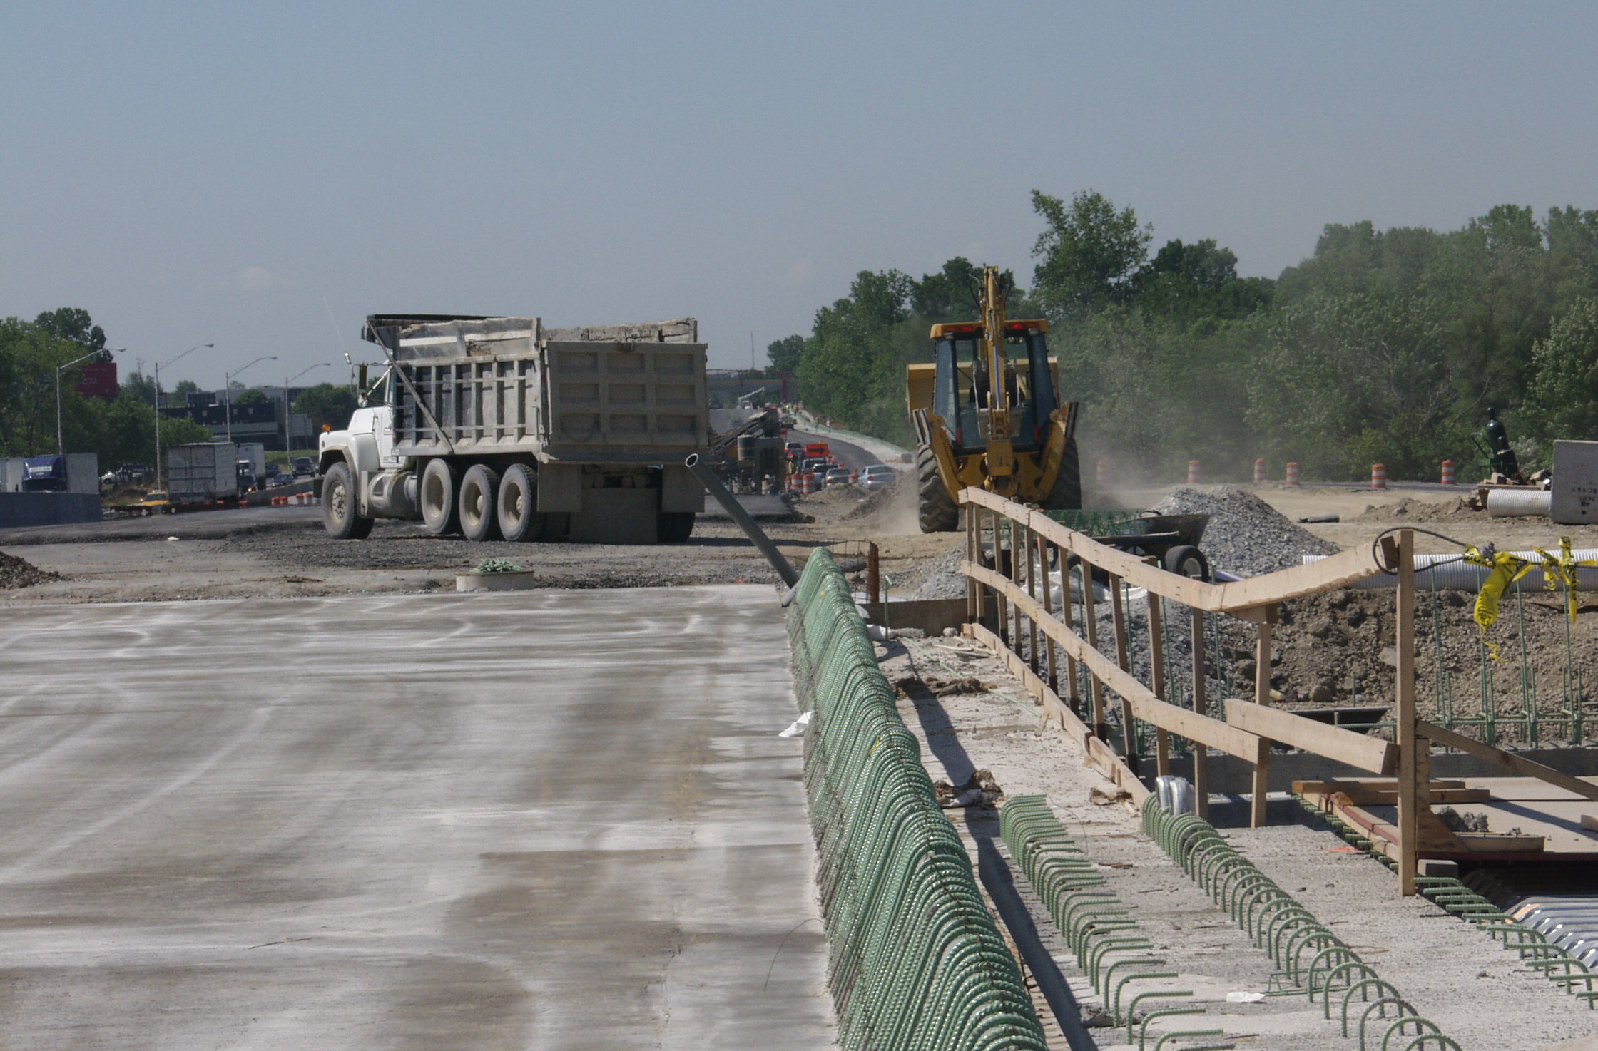
Safely Working Around Trucks and Equipment

Slide 45
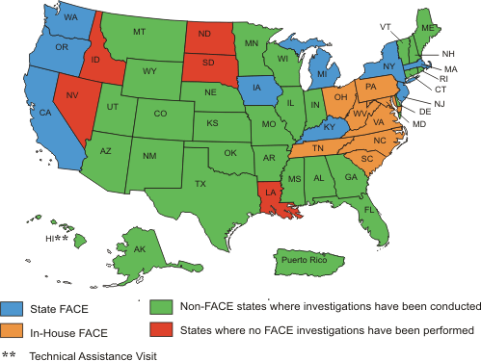
Fatality Assessment and Control Evaluation States Participating in the Program

Slide 46
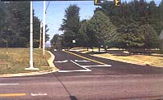
Laborer Run Over by Dump Truck at Roadway Resurfacing Operation in Virginia
Two-lane County Road Intersection with Four-lane State Highway
Source: NIOSH FACE-98-19

Slide 47

Flagger
Truck
Roller
Victim
Trees
Victim’s Work Area
Paving Machine

Slide 48
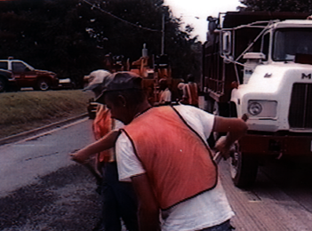
View from the Street
Notes:
An example of how FACE identifies risk, is the case of a laborer who died during July of 1998 while working at a resurfacing operation

Slide 49
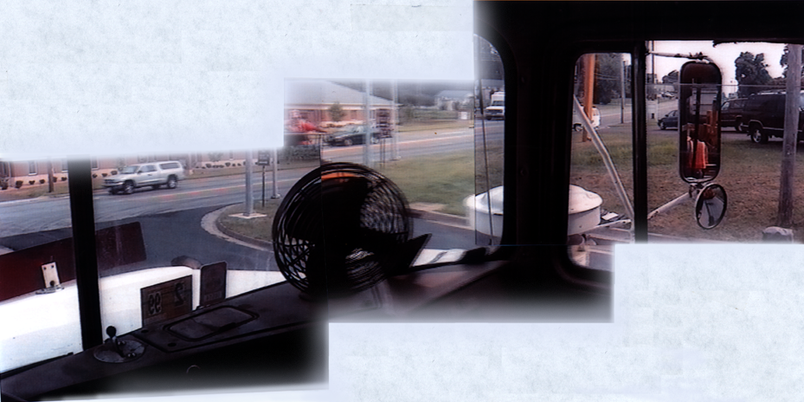
View from Inside the Cab
Stickers
Bug Shield
Mirror
Fan
Air Cleaner and Door Post

Slide 50
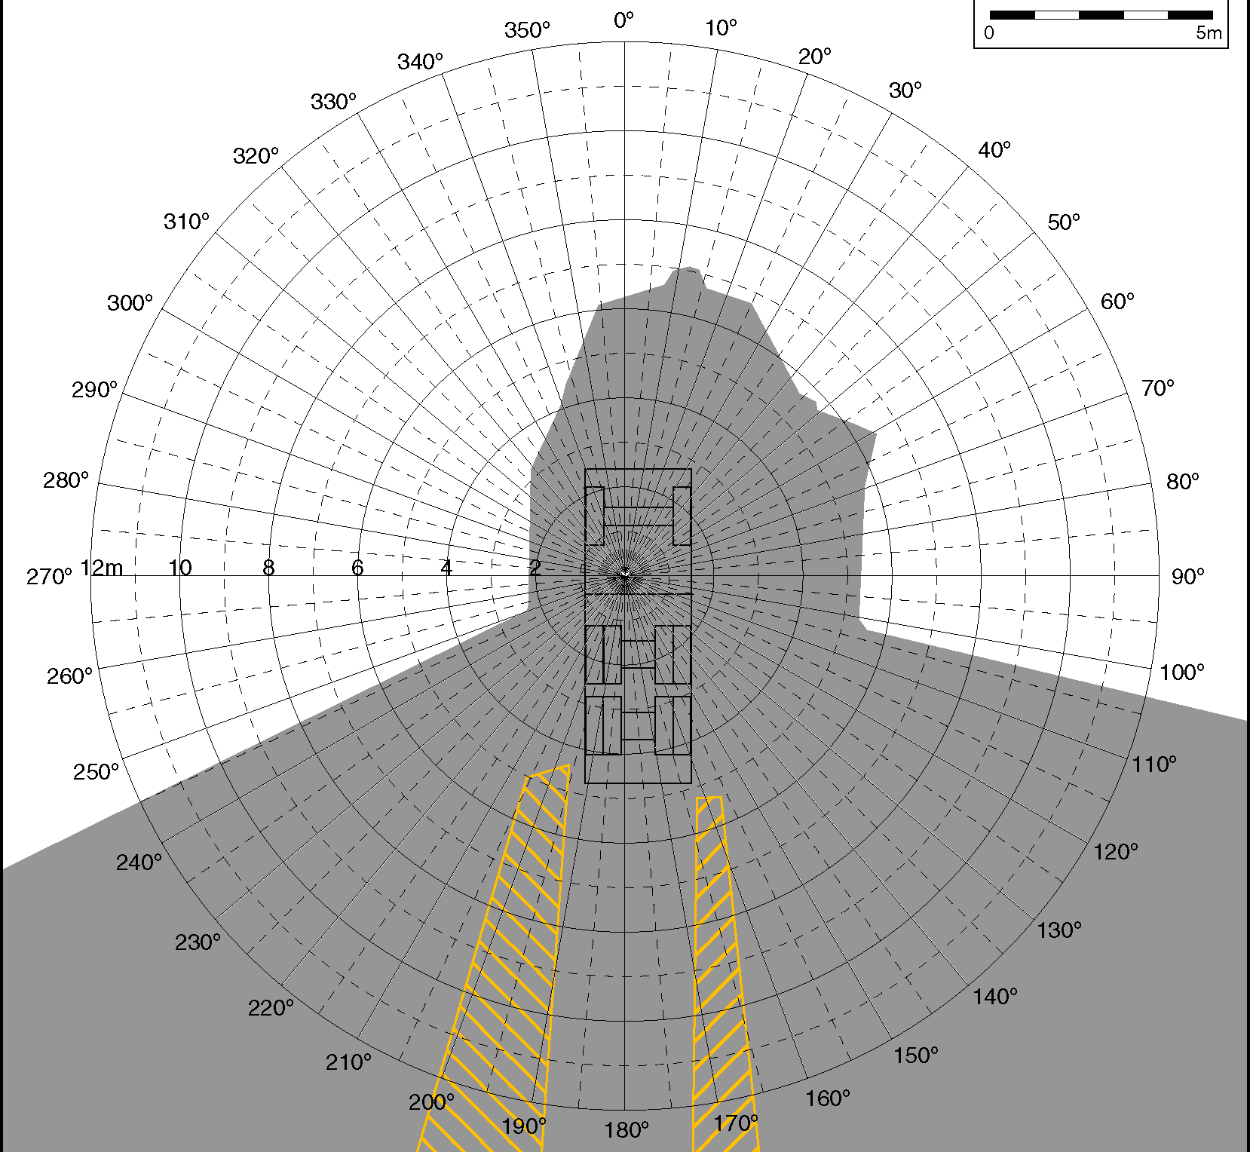
Blind Area
Dump Truck
Notes:
The next 3 slides show the area around different pieces of equipment where the operator can not see a 3 foot tall barrel. Consider this the height of a person bent over to pick something up off the ground. The grey area is blind to the operator. The yellow area is visible with the use of mirrors.
This is the blind area diagram for a 3-axle dump truck. Notice the blind area extends 6-7 meters (18-21 feet) in front of the truck and that a relatively small percentage of the blind area to the side and rear of the truck is covered by the mirrors, shown here in yellow. Also keep in mind the driver is usually focused on the drivers side when backing, making the area to the right rear of the truck particularly dangerous.

Slide 51
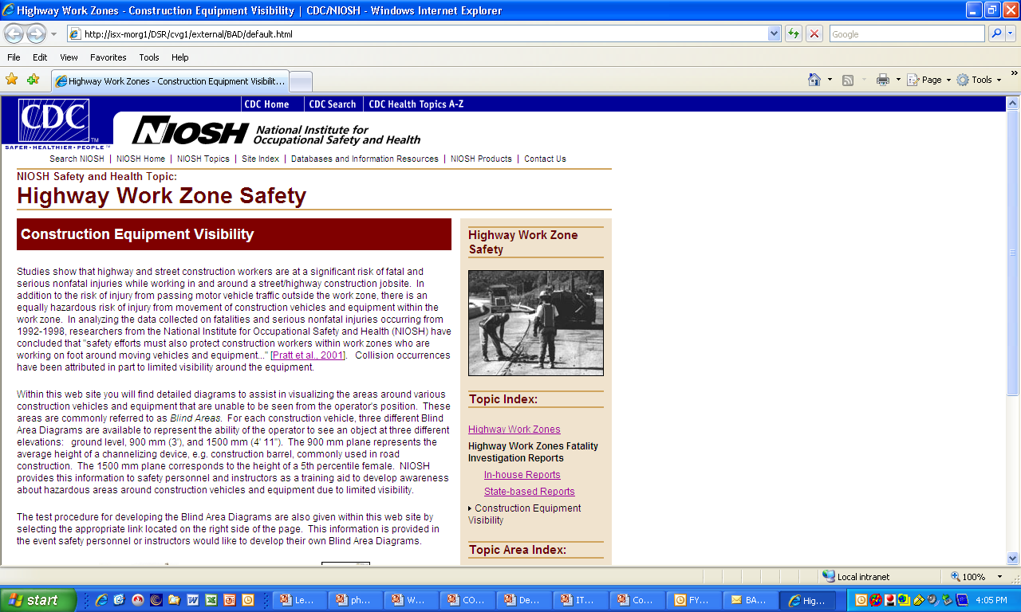
WWW.CDC.GOV/NIOSH/TOPICS/
HIGHWAYWORKZONES

Slide 52
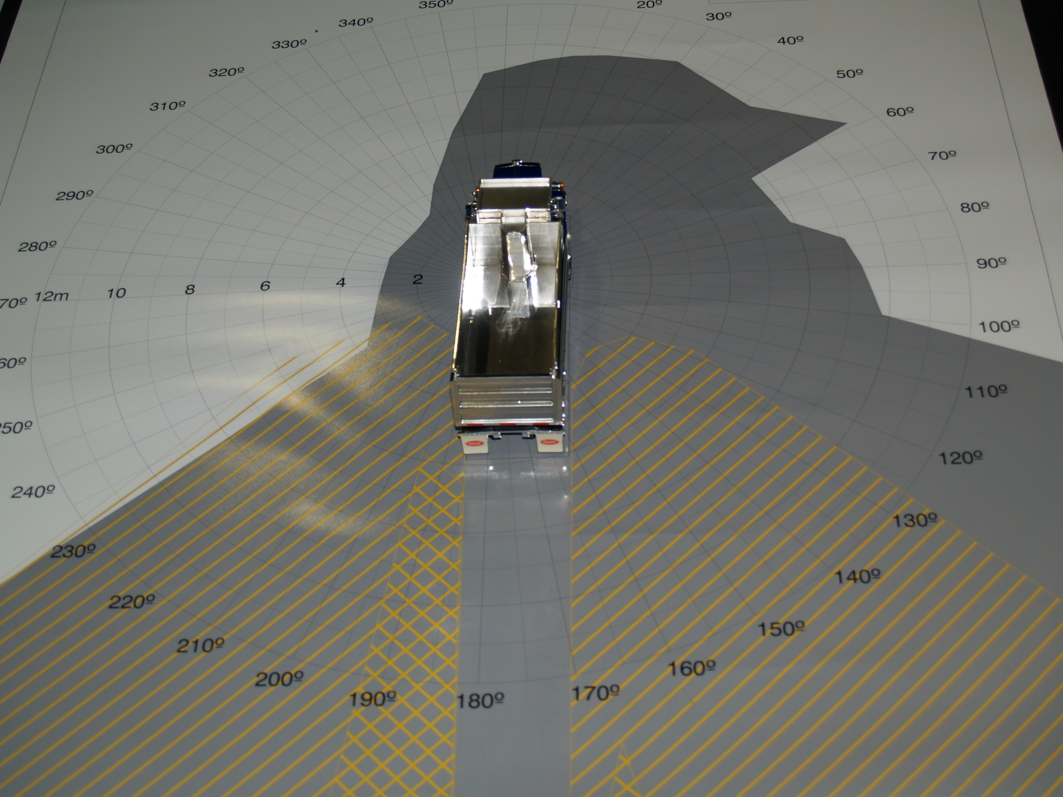

Equipment Blind Areas

Slide 53
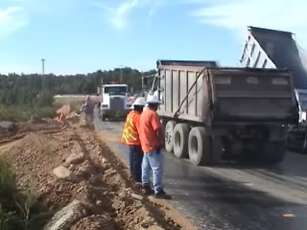
Efficacy of Site Safety?

Slide 54
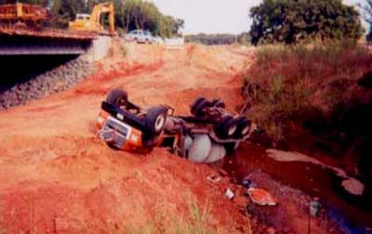
Driver Died When Mixer Truck Overturned
Source: Oklahoma Case Report: 00-OK-073
Notes:
43 year-old truck driver died from injuries received when the concrete mixer truck he was driving overturned into a creek bed.

Slide 55
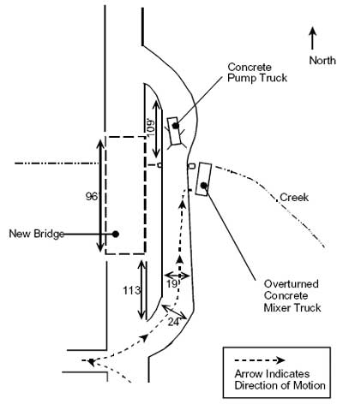
Notes:
Explain the scene.
The incident occurred on a low water temporary “haul” road that was constructed approximately four months prior to the incident on the east side of the bridge to move equipment and materials across the creek between the north and south sides of the project.
The low water bridge consisted of three-foot diameter culvert positioned in the creek bed. 318 feet in length, ranging from 19-24 feet wide, constructed of compacted indigenous earth to a level approximately four feet above the top of the culvert (7-8 feet above the creek bed).
The victim was the first of six trucks to be dispatched to the site that day. His truck was loaded and he left for the bridge site.
The concrete pumper truck arrived at the south side of the bridge site shortly after the victim.
The pump truck indicated to the bridge contractor foreman that additional staging space would be needed at the setup point near the north end of the haul road to accommodate the vehicles outriggers and pads.
The foreman instructed a dozer operator to make necessary alterations to the haul road.
When the alterations were completed the pump truck driver crossed the low water bridge and positioned his vehicle near the north end of the haul road.
When the victim arrived on the south side of the site he contacted the superintendent for instructions, and he was instructed to wait at the turn around point at the south end of the bridge until the pumper truck was set up.
A second concrete mixer truck also waited while the pump truck was positioned and set up for the pour.
As the pump truck driver and bridge contractor were completing the pump truck set up, the bridge contractor foreman instructed the first mixer driver to turn his truck around and prepare to back across the low water bridge.
The driver positioned his vehicle squarely in the haul road and began backing down the incline toward the low water bridge.
A bridge contractor employee observed the truck backing at an angle and shouted a warning as the truck began to slide towards the edge of the road.
The victim attempted to exit the vehicle on the passenger side, the truck hesitated then rolled into the creek bed as a section of the road (measuring approximately twelve feet in length, and five feet in width) sheared off the road shoulder and collapsed into the creek.
The mixer drum flipped completely over, landing upside-down in a creek bed and slamming the cab into the steep creek bed.

Slide 56
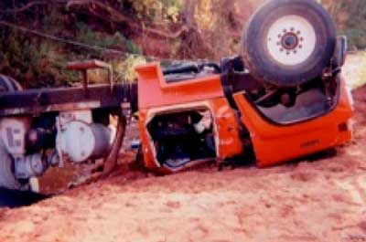
Notes:
View of the crushed truck cab.
The impact crushed the roof of the cab and trapped the driver inside the vehicle.
Recommendation #1: If a thorough review is conducted in preparation for road construction then hazards and risk can be eliminated and/or controlled.
Investigators found the material at the edge of the road crumbled easily to touch.
Recommendation #2: Proper engineering principles should be applied to the design and construction of any temporary haul road where critical hazards and risks have been identified.
Recommendation #3: Inspection and maintenance requirements should be appropriate for the environmental conditions and intended use of the road.
The area was experiencing a serious drought at the time of the incident, resulting in lack of cohesion from the absence of moisture in the road material.
Recommendation #4:
Employers should establish written policies that require vehicle operators to inspect any temporary road.
Recommendation #5:
Employers should establish written policies that require vehicle operators to obtain the assistance of a guide while backing vehicles.

Slide 57
Recommendations
  Recommendation #1:
    Employers should conduct a thorough hazard review.
      Investigators found the material at the edge of the road crumbled easily to touch.
  Recommendation #2:
    Employers should utilize a competent engineer.
  Recommendation #3:
    Employers should ensure that engineering specifications for any temporary haul road include inspection and maintenance requirements.
Notes:
Recommendation #1: If a thorough review is conducted in preparation for road construction then hazards and risk can be eliminated and/or controlled.
Investigators found the material at the edge of the road crumbled easily to touch.
Recommendation #2: Proper engineering principles should be applied to the design and construction of any temporary haul road where critical hazards and risks have been identified.
Recommendation #3: Inspection and maintenance requirements should be appropriate for the environmental conditions and intended use of the road.
The area was experiencing a serious drought at the time of the incident, resulting in lack of cohesion from the absence of moisture in the road material.
Recommendation #4:
Employers should establish written policies that require vehicle operators to inspect any temporary road.
Recommendation #5:
Employers should establish written policies that require vehicle operators to obtain the assistance of a guide while backing vehicles.

Slide 58
Recommendations
Recommendation #4:
    Employers should establish written policies that require vehicle operators to inspect any temporary road.
Recommendation #5:
  Employers should establish written policies that require vehicle operators to obtain the assistance of a guide while backing vehicles.
Notes:
Written policies should require vehicle operators to inspect any temporary road or other off-road terrain before attempting to drive a vehicle in such locations.
Recommendation #5: When backing vehicles into or through any hazardous area employers should establish written policies that require vehicle operators to obtain the assistance of a guide.

Slide 59
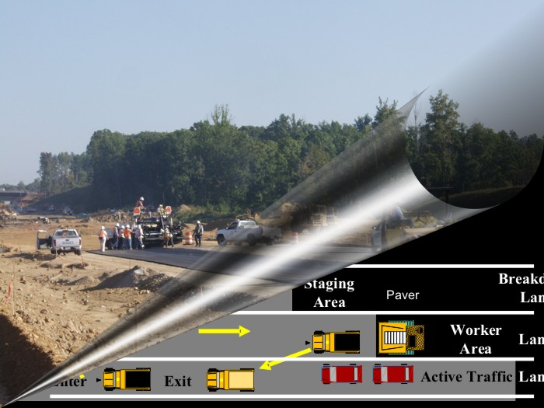
Internal Traffic Control Plans
Notes:
Good Afternoon,
Thank you for your interest in making work zones safer– both for the workers that occupy the work space and for the road users that travel through the traffic space. Of all work zone issues, the issues surrounding getting work vehicles and equipment from active traffic into the work area and back again requires optimization of work zone safety on both sides of the barrels. Safe access/egress is critical to work zone safety, yet unfortunately is not typically thought out early enough in the design and build stages of a project.

Slide 60
ITCP Key Principles
Key Principles of an ITCP are:
  Limit access points to the work zone
  Reduce the need to back up equipment
  Coordinate truck and equipment movements
  Establish worker-free zones
  Inform workers of the ITCP

Slide 61
Notes:
Explain the scene.
The incident occurred on a low water temporary “haul” road that was constructed approximately four months prior to the incident on the east side of the bridge to move equipment and materials across the creek between the north and south sides of the project.
The low water bridge consisted of three-foot diameter culvert positioned in the creek bed. 318 feet in length, ranging from 19-24 feet wide, constructed of compacted indigenous earth to a level approximately four feet above the top of the culvert (7-8 feet above the creek bed).
The victim was the first of six trucks to be dispatched to the site that day. His truck was loaded and he left for the bridge site.
The concrete pumper truck arrived at the south side of the bridge site shortly after the victim.
The pump truck indicated to the bridge contractor foreman that additional staging space would be needed at the setup point near the north end of the haul road to accommodate the vehicles outriggers and pads.
The foreman instructed a dozer operator to make necessary alterations to the haul road.
When the alterations were completed the pump truck driver crossed the low water bridge and positioned his vehicle near the north end of the haul road.
When the victim arrived on the south side of the site he contacted the superintendent for instructions, and he was instructed to wait at the turn around point at the south end of the bridge until the pumper truck was set up.
A second concrete mixer truck also waited while the pump truck was positioned and set up for the pour.
As the pump truck driver and bridge contractor were completing the pump truck set up, the bridge contractor foreman instructed the first mixer driver to turn his truck around and prepare to back across the low water bridge.
The driver positioned his vehicle squarely in the haul road and began backing down the incline toward the low water bridge.
A bridge contractor employee observed the truck backing at an angle and shouted a warning as the truck began to slide towards the edge of the road.
The victim attempted to exit the vehicle on the passenger side, the truck hesitated then rolled into the creek bed as a section of the road (measuring approximately twelve feet in length, and five feet in width) sheared off the road shoulder and collapsed into the creek.
The mixer drum flipped completely over, landing upside-down in a creek bed and slamming the cab into the steep creek bed.

Slide 62
ITCP Recommendations
Integrate
Company
State employees
Trucking company
Sub-contractors
Inform
Irregular personnel
Implement
Parking
Take Timeout
Revise
Truck drivers
Re-communicate
Sub-contractors

Slide 63
10 MPH is faster than you think!!!
MPH | Feet in 1.0 Second | Feet in 2.5 Seconds
10 | 15 | 37
20 | 29 | 74
30 | 44 | 110
40 | 59 | 147
50 | 74 | 184
60 | 88 | 220
70 | 103 | 257
80 | 118 | 294
A Dump Truck Backing at 10 MPH Covers 14.7 Feet
In 1 Second!!!!!!!!

Slide 64
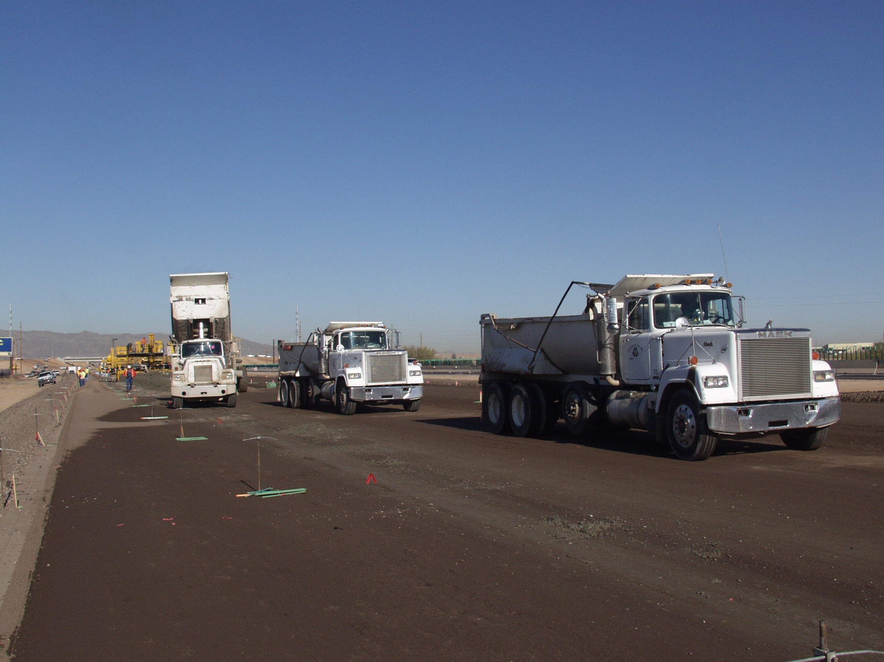
Worker Dies After Being Backed Over By a Rear End Dump Truck
Source Minnesota Face Program (MN9207)
Notes:
Some of these photos are not associated with the actual site.
This case occurred during the asphalt base lay down part of a on a concrete paving job.
A 45-year-old boom truck is driver run over by dump truck that was backing during a repositioning maneuver.

Slide 65
Concrete Paving Operation Layout
Turn-around
Paver
Truck Line
Notes:
Describe scenario.
Paving train moving in this direction
Paver is here
Turn around is here..
Traffic exits here

Slide 66
Truck Queue Repositioning
Turn-around
New
Truck
Last
Truck
Truck Line
X
Notes:
The victim (here) was instructing a line of seven trucks in a paving train to back up to a new location.
He proceeded to the last truck(here) and gave instructions as to where to move.
At the same time a new truck(here) was coming to the line from the rear.
While signaling the new truck to stop, the last truck began turning and backing up to make way for the new truck. The victim was in the path of the last truck and the driver’s blind spot. The victim was hit and pushed 14 feet on the blacktop.
Some measures that could be taken to prevent this from happening again would be to develop an Internal Traffic Control Plan which we will discuss later, determine pedestrian free zones, ensure communication and install proximity warning systems.

Slide 67
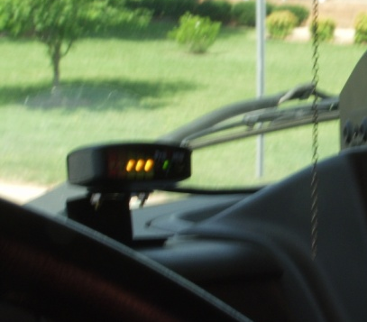
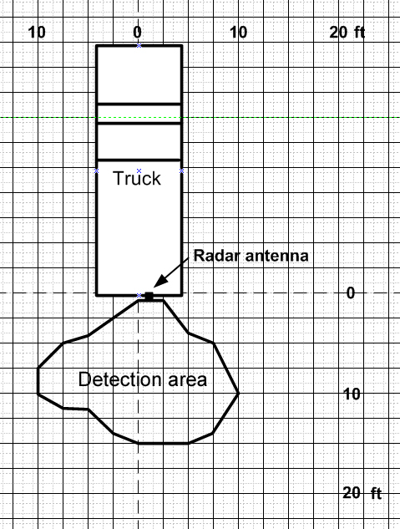
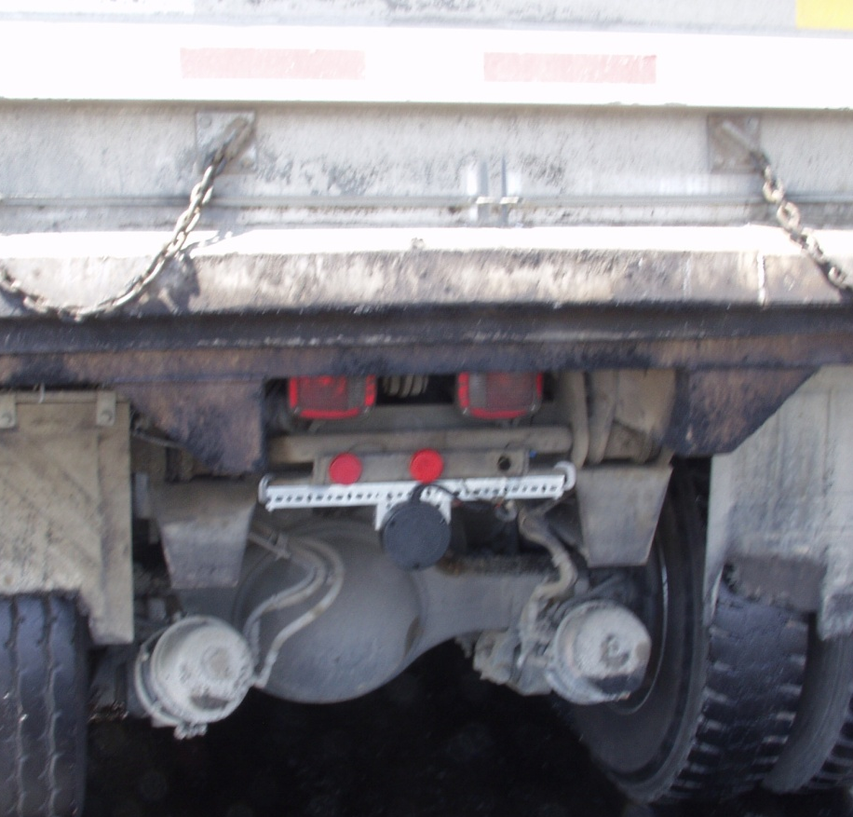
Proximity Warning Systems
Preco Preview

Slide 68

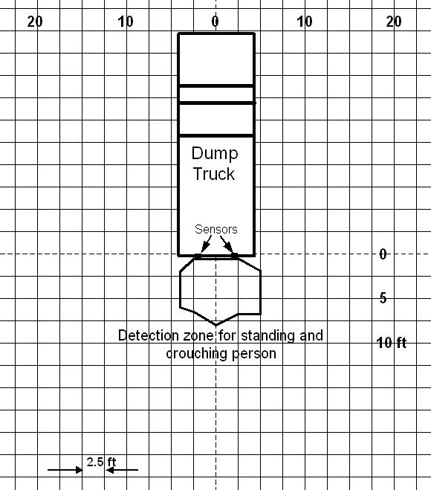
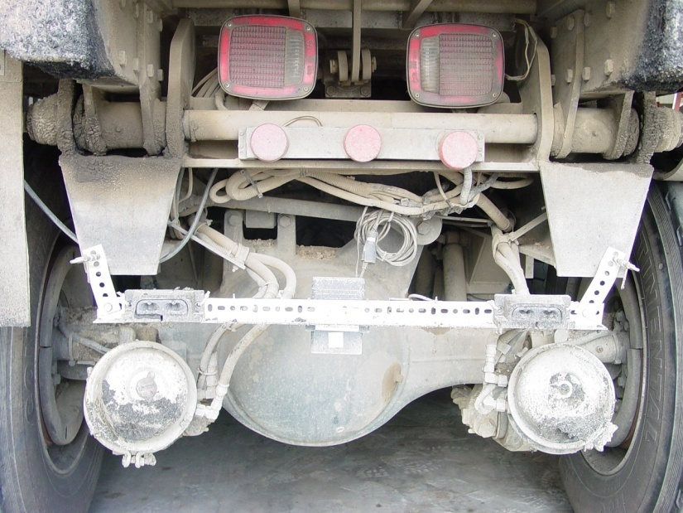
Proximity Warning Systems
Hindsight 20/20

Slide 69
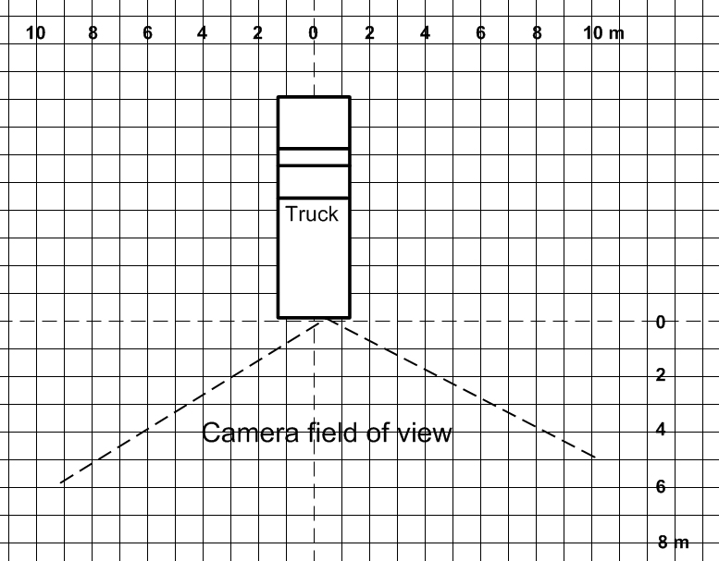
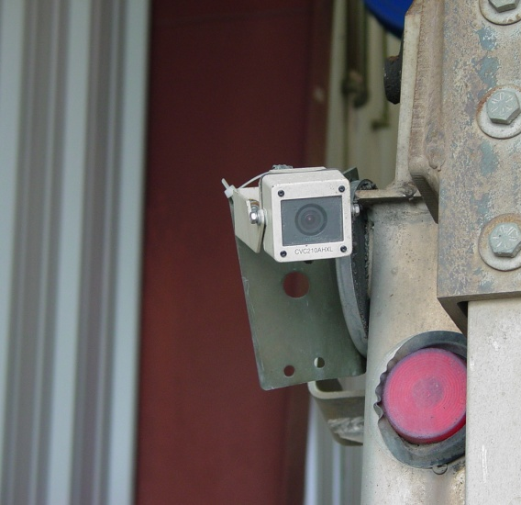
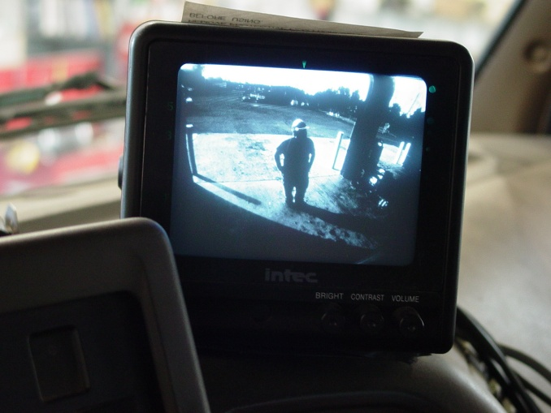
Proximity Warning Systems
Intec Camera

Slide 70
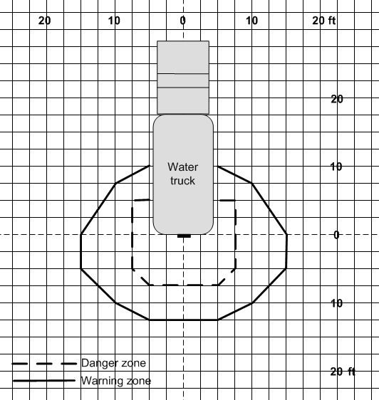
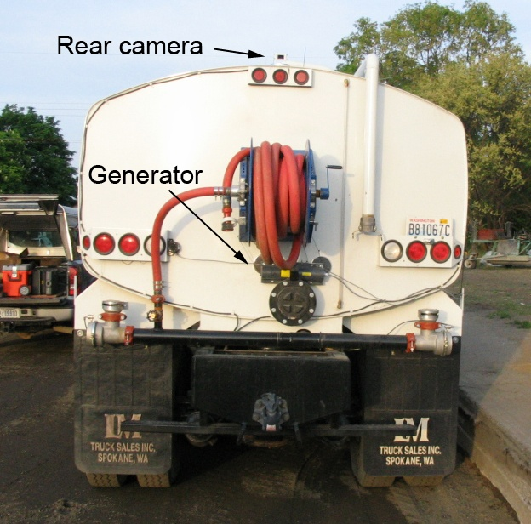
Detection Zones
Generator
Notes:
This is the detection zone on the water truck. Again it extends to about 12 ft behind the truck and 11 ft to the sides. The more critical warning is generated in the danger zone here that extends out about 7 or 8 ft.

Slide 71
PWS Recommendations
Sonar
Flush mount
Short range
Radar
Good range
Nuisance alarms
Camera
View of blind area
No alarm
Nuisance alarms
Operates when dirty/wet
Dirt/water
Requires daily maintenance

Slide 72
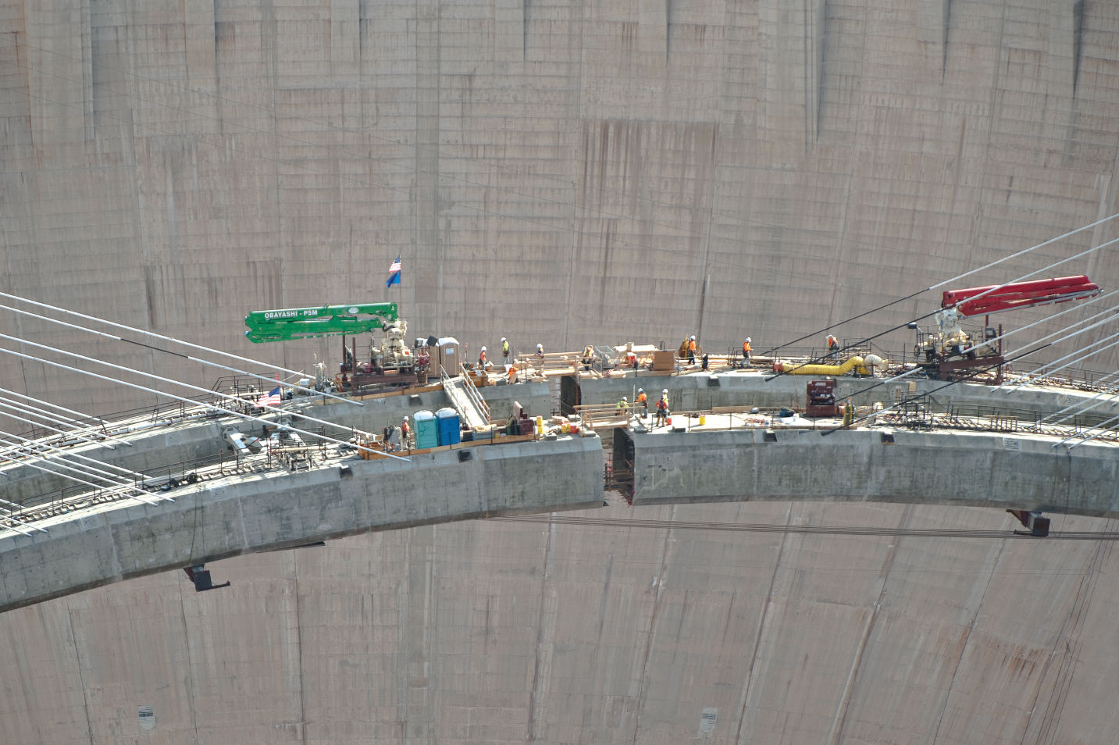
Road & Bridge Construction Hazards

Slide 73
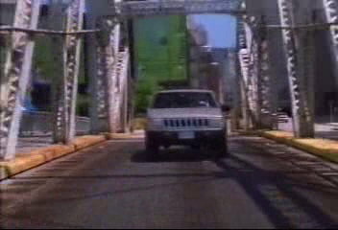
Efficacy of Channelizing Devices?

Slide 75
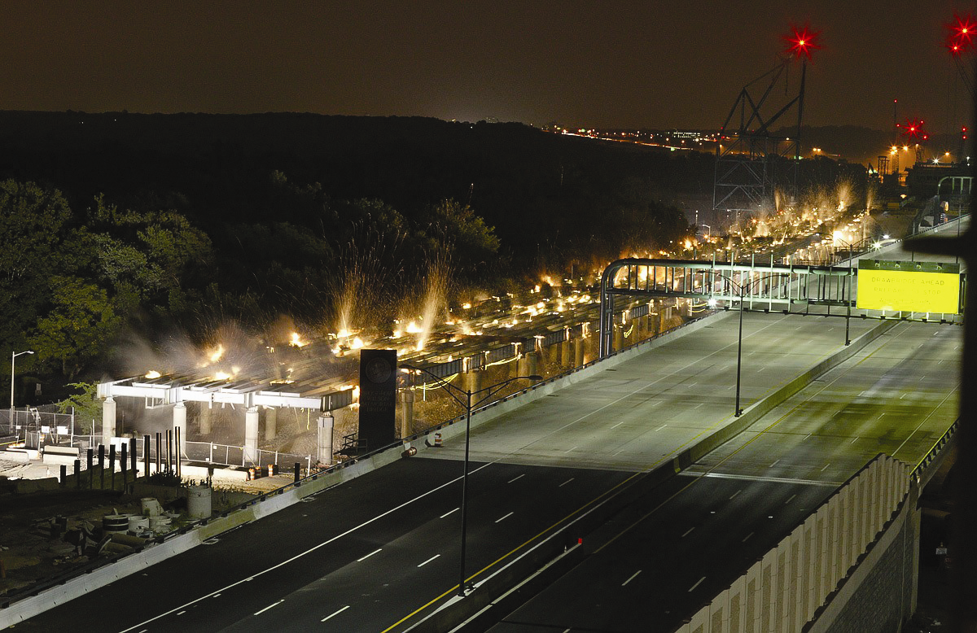
Separating Workers From traffic

Slide 76
Subpart K: Temporary Traffic Control Devices Rule
Effective date: December 4, 2008
Purpose: to decrease the likelihood of highway work zone fatalities and injuries to workers and road users
Notes:
The Federal Highway Administration final rule codified in 23 CFR Part 634 Subpart K, the Temporary Traffic Control Device Rule, which took effect in December 2004. The purpose of this rule was to decrease the likelihood of highway work zone fatalities and injuries to workers and road users alike. There are a number of key components to Subpart K…

Slide 77
Subpart K: Temporary Traffic Control Devices Rule
Safety in work zone policy
Positive protection
Exposure control measures
Other traffic control measures
Uniformed law enforcement
Safe entry/exit for vehicles and equipment
Payment of traffic control
Quality guidelines
Notes:
This slide shows the key components, but what is important to note is that now FHWA mandates on Federal Aid projects that we consider Safe entry/exit for vehicles and equipment, as part of work zone planning AND that this consideration be a part of State Agency work zone policy. The intent of this policy is to make it no longer standard practice to wait until the project is underway before we consider how work vehicles and equipment will interact with traffic!!!

Slide 78
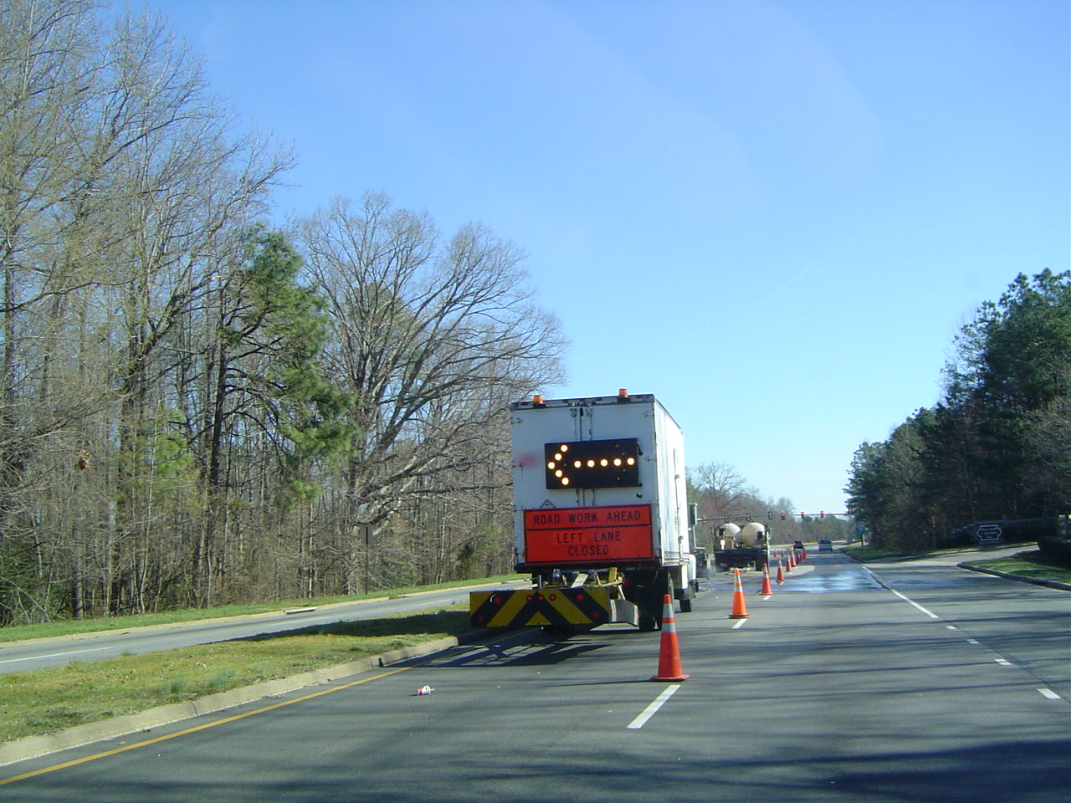
Traffic Control Devices: Good Positive Guidance for the Motorist

Slide 79
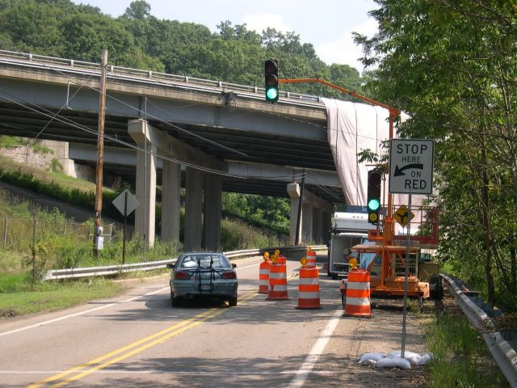
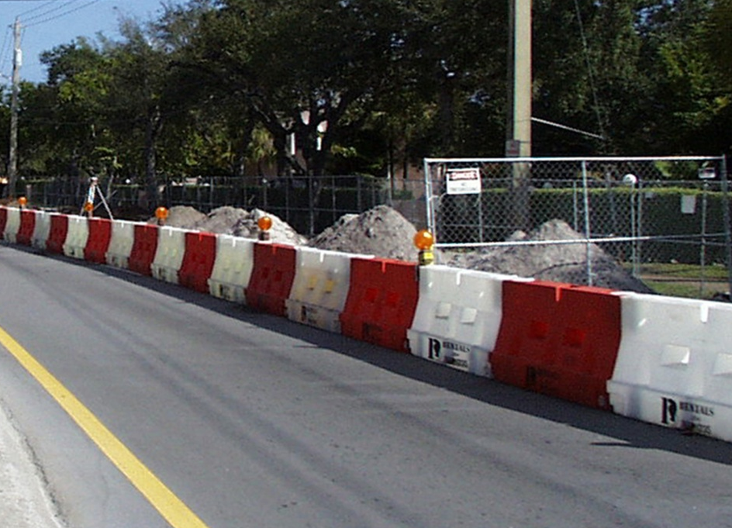
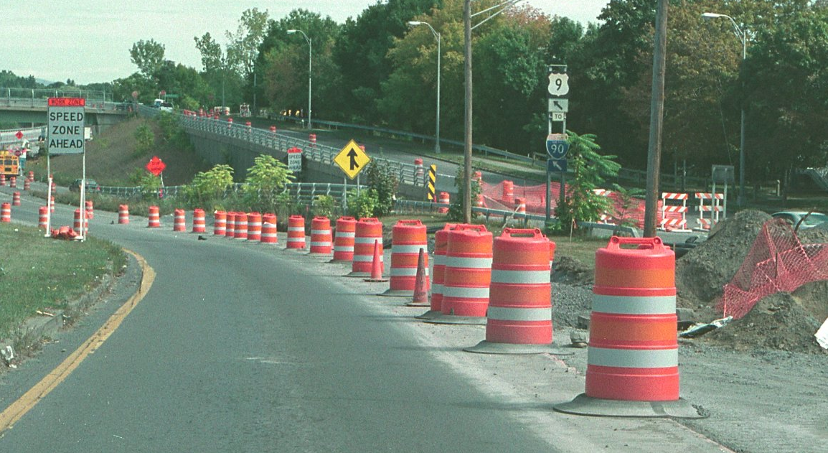

Slide 80



Slide 81


Slide 82


Slide 83



Slide 84


Notes:
So what are the key factors at the project level that need to be considered when planning access points? Let’s start by talking about the scenario represented by this typical from the Millennium Edition of the MUTCD. This is of an interstate project with a median crossover to move traffic from the lanes being worked. The photo is from a project in Indiana where the entry is from an on-ramp to an interstate highway with a similar traffic control setup as the drawing. How are we going to get in and out of the workspace represented by the hatched box in the drawing. A pretty standard approach is for arriving vehicles to decelerate in the breakdown lane or the slow speed lane and enter the worksite between barrels in the transition area. Then weave around the Type III barricade that signifies road closure.

Slide 85


Slide 86

Safe Entry & Exit

Slide 87







Slide 88
Agencies should also address safe means for work vehicles and equipment to enter and exit traffic lanes and for delivery of construction materials to the work space based on individual project characteristics and factors
Notes:
This increase emphasis on improving access and egress safety is exemplified in the language of subpart K, which states, “Agencies should also address safe means for work vehicles and equipment to enter and exit traffic lanes and for delivery of construction materials to the work space based on individual project characteristics and factors.”

Slide 89

Notes:
This photo is from a new divided highway being built in West Virginia. Entrance to this worksite was from a lightly used secondary roadway leading from a two-lane State highway. The intersection of the secondary roadway with the State highway was controlled by a stop sign. On the project end of the access road, asphalt trucks crossed this bridge and entered the work area via the access ramps.

Slide 90

The Typical Interstate Project
Source: Steve Hubbard

Slide 91

Source: Steve Hubbard
Notes:
Trucks entering Work Zone put motorist and those on other side of wall at risk

Slide 92


What is the most common method of entering and exiting work zones in the United States?
Notes:
Probably the most common way of entering and exiting the work space is to adjust your speed as minimally as possible (to avoid being rear-ended) and dodging between barrels, cones, and tubular markers. How many projects have you been on where everyone on site believes there must be a safer way, but where no one actually implements any changes to make accessing the work site any safer?

Slide 93

Notes:
This photo shows the difficult task faced by truck drivers delivering asphalt to the site. They had to get a dump truck from zero to 55 mph in less than 40 feet, while accelerating on a gravel slope and entering traffic at an abrupt angle. Dave will talk about better alternatives to this work zone access/egress point later in his presentation. However, this slide does emphasize the relationship of the internal traffic control plan and the traffic control plan at locations where construction vehciles and equipment enter and exit the work space…

Slide 94




Trucks Entering Traffic

Slide 95


Past Deployments
Trucks Entering / Exiting
Slow Speed Advisory

Slide 96

Notes:
As you look at this photo consider what motorists see as they wind around the barrier wall, through the work site and pass the entrance for work vehicles. Any chance of confusion on the motorists’ part. What if the barrels are too wide apart? What if the striping is not there? Dave is now going to talk about some of the things that can be done to reduce motorists confusion, ensure construction operators know where the access points are going to be, and reduce the chance of conflict between construction traffic and motorist traffic, as well as between construction traffic and construction ground crews.

Slide 97

Notes:
This photo is from a different jobsite in Indiana. The work space is to the left of the barrel line and the traffic space is to the right of the barrels. This ramp was set up for construction vehicles to exit the jobsite. What safety concerns might this photo suggest?

Slide 98


Notes:
An important consideration is how activities in the work space might impact the ability of construction vehicles and equipment to get into or out of the work space. On this particular job, the work was being done within the median, with traffic on both sides of the job site. Access points were at breaks in the concrete barrier wall, with barrels used to close openings when the access point was not to be used.

Slide 99

Notes:
Consider where vehicles can park and be out of the way. Are there locations that vehicles should not park because they might limit sight distance of construction traffic entering the work site, or of motorists driving past the work site?

Slide 100

Notes:
This photo shows the proximity of the access points to the high-speed traffic lane. This work zone was in an urban area near several exits, so truck traffic passing through the work zone was moved to the left lane away from the ramps and up against the barrier wall separating the traffic space from the work space.

Slide 101

Source: Steve Hubbard

Slide 102

Source: Steve Hubbard
Notes:
Trucks Backed up inside the work zone create problems as they wait to exit

Slide 103

Notes:
How does the foreman or site superintendent go about developing an internal traffic control plan. They start with the site drawings and consider what work will be done for the day. What lanes are being worked on? What is being done first. What activities will happen later in the day? Who else is working in the area?

Slide 104




Trucks Exiting Traffic

Slide 105


Slide 106



Truck Activated Caution Message

Slide 107



Trucks Entering Traffic

Slide 108


Slide 109



Signs Activated by Trucks
Wireless sensor location along haul road

Slide 110
Safe entry and exit from the work space
Innovation - Design/Build Ramp
  Limit entry into high-speed traffic stream
  Utilize overpass and local street traffic control signals
Source: Steve Hubbard

Slide 111

Source: Steve Hubbard

Slide 112

Source: Steve Hubbard

Slide 113

Source: Steve Hubbard
Notes:
All equipment, vehicles and employee parking should remain clear of areas where trucks need to enter the Work Zone

Slide 114

Source: Steve Hubbard

Slide 115

Notes:
The ITCP should also account for how the activities of other crews on site impact movement of construction traffic vital to your operations. This site had a concrete barrier wall being poured at the same time as paving operations. The concrete pour greatly reduced the travel lane operations for the arriving asphalt trucks.

Slide 116

Notes:
Once all the ordinary activity occurring on site is accounted for, the foreman must consider unusual activities, such as site visitors, emergency responders, and equipment breakdowns. This is our research pickup truck/trailer combination at a site in Indiana. The trailer has a pneumatic mast that extends up to 60 feet and has two video cameras mounted on top. We used this system to videotape paving operations so that we could later view the video to correlate our data with on-site activities. The foreman on this site had to incorporate into the ITCP how we would bring the trailer onto the site, where we would setup for video taping, and how we would get it off site at the end of the day.

Slide 117

Source: Steve Hubbard

Slide 118

Notes:
Map out how construction equipment will get onto and off of the work site. Consider what special precautions need to be taken when the work activity must pass through the traffic space, such as when paving past off ramps open to traffic.

Slide 119

Source: Steve Hubbard

Slide 120

Source: Steve Hubbard
Notes:
Devices need to be well maintained at the access/egress point

Slide 121

Source: Steve Hubbard

Slide 122

Safe entry and exit from the work space
Controlled access points
Entering and exiting vehicles same direction as traffic
Signage – Truck, VMS, Static
Work scheduling

Slide 123
It’s Here Now!
  Temporary Traffic Control
  Expanded Night Work Module
  Expanded Runovers and
  Backovers Module
  Disaster Response
4 New Topics
Notes:
123

Slide 124


Slide 125
ANSI Standards
Development
ANSI A10 Standard for Roadway Construction
Topics Include:
  Traffic Control
  Flagger Safety
  Runover/Backover Prevention
  Equipment Operator Safety
  Health Hazards
  Night Work
  Personal Protective Equipment
Notes:
125

Slide 126

Thank you!
Contact Information:
David E. Fosbroke
NIOSH
Division of Safety Research Morgantown, WV
(304) 285-6010
dFosbroke@cdc.gov
Jennifer E. Lincoln
NIOSH
Division of Safety Research Morgantown, WV
(304) 285-6010
JELincoln@cdc.gov
Notes:
The End

Slide 127


Slide 128

800-CDC-INFO (800-232-4636)

