Slide 1
Work Zone Crash Mitigation Solutions
National Symposium on Work Zones and Large Trucks
Steven Smith and Chris Flanigan
March 18, 2015

Slide 2
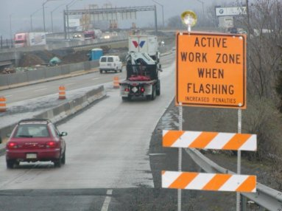
Work Zone Video

Slide 3
Work Zone Crash Statistics (2008-2012)
Percent of Fatal Crashes Involving a Large Truck by Crash Type
Source: USDOT, NHTSA, FARS, available at: http://www.nhtsa.gov/FARS

Slide 4
Work Zone Crash Statistics (2012)
Large truck involvement in work zone fatal crashes is more frequent than in fatal crashes in general
  24 percent of 547 fatal crashes in work zones involved at least one large truck
  11 percent of all fatal crashes (30,800) involved a large truck
Large truck fatal crashes in work zones more frequently involve three or more vehicles
  33 percent of large truck fatal crashes in work zones involved three or more vehicles
  17 percent of large truck fatal crashes in general involved three or more vehicles.

Slide 5
Outreach Activities
FMCSA and FHWA held a stakeholders meeting in Knoxville, TN on November 13, 2015, was held to discuss:
  current state efforts to address work zone crashes;
  solutions utilizing existing technologies; and
  potential research areas
Annual Convention and Traffic Expo American Traffic Safety Services Association
  Discussed safety issues pertaining to roadside workers and technology solutions

Slide 6
Outreach Activities
Working with a number of states to explore their support of potential technology solutions:
  Tennessee, North Carolina, Kentucky, Georgia, Mississippi, Louisiana, Texas, and Illinois
Work Zone Symposium at Commercial Vehicle Safety Alliance Conference in Jacksonville, FL, provides a forum to discuss potential solutions

Slide 7
What We Now Know – CMRS Vendors
CMRS vendors have initiated work on work zone information collection and distribution
  Work zone information only updated once a day at most
  Depending on time of day the traffic flow may not always be affected by the work zone
Data issues need exploration

Slide 8
What We Now Know – State DOTs
NC has tested deployable technologies (e.g., iCones) that allow identifying the end of the queue at a work zone.
TN is deploying a new initiative: Protect the Queue, a measure aimed at raising awareness near work zones
Each state is developing message trucks to place upstream of incidents to alert motorists

Slide 9
Two Potential Technology Solutions
Solution | Challenges | Status
Commercial Mobile Radio Services (CMRS) application | Application requires real time reliable data | Data issues being identified and alternative solutions being examined
Roadside Equipment/In-cab receiver and Interface | Equipping vehicles with receivers | Demonstrated in Maryland in 2014

Slide 10
Next Steps
Continue to work with states to better understand their data provision protocols
Engage stakeholders in the CMRS industry, third party brokers of work zone/traffic information, and representative carriers
Develop a standard work zone logistics message set that could be utilized by interested CMRS vendors in developing an alert application

Slide 11
Discussion Items
Barriers to delay real time work zone related data for CMRS broadcast
Assessment from CMRS providers
FHWA plans for roadside equipment/in-cab interface
Other ideas?

Slide 12
Links to Further Information
FMCSA Work Zone Analysis Brief:
http://ntl.bts.gov/lib/54000/54100/54128/14-006_-_Work_Zone_Fatal_Crashes_-_Final_-_508C.pdf
Knoxville Stakeholder Meeting Report:
https://cms.fmcsa.dot.gov/sites/fmcsa.dot.gov/files/docs/Work%20Zone%20Mtg%20Report%20-%20November%202014%20-%20Section%20508C.pdf

