Slide 1
Keeping You Moving

Slide 2
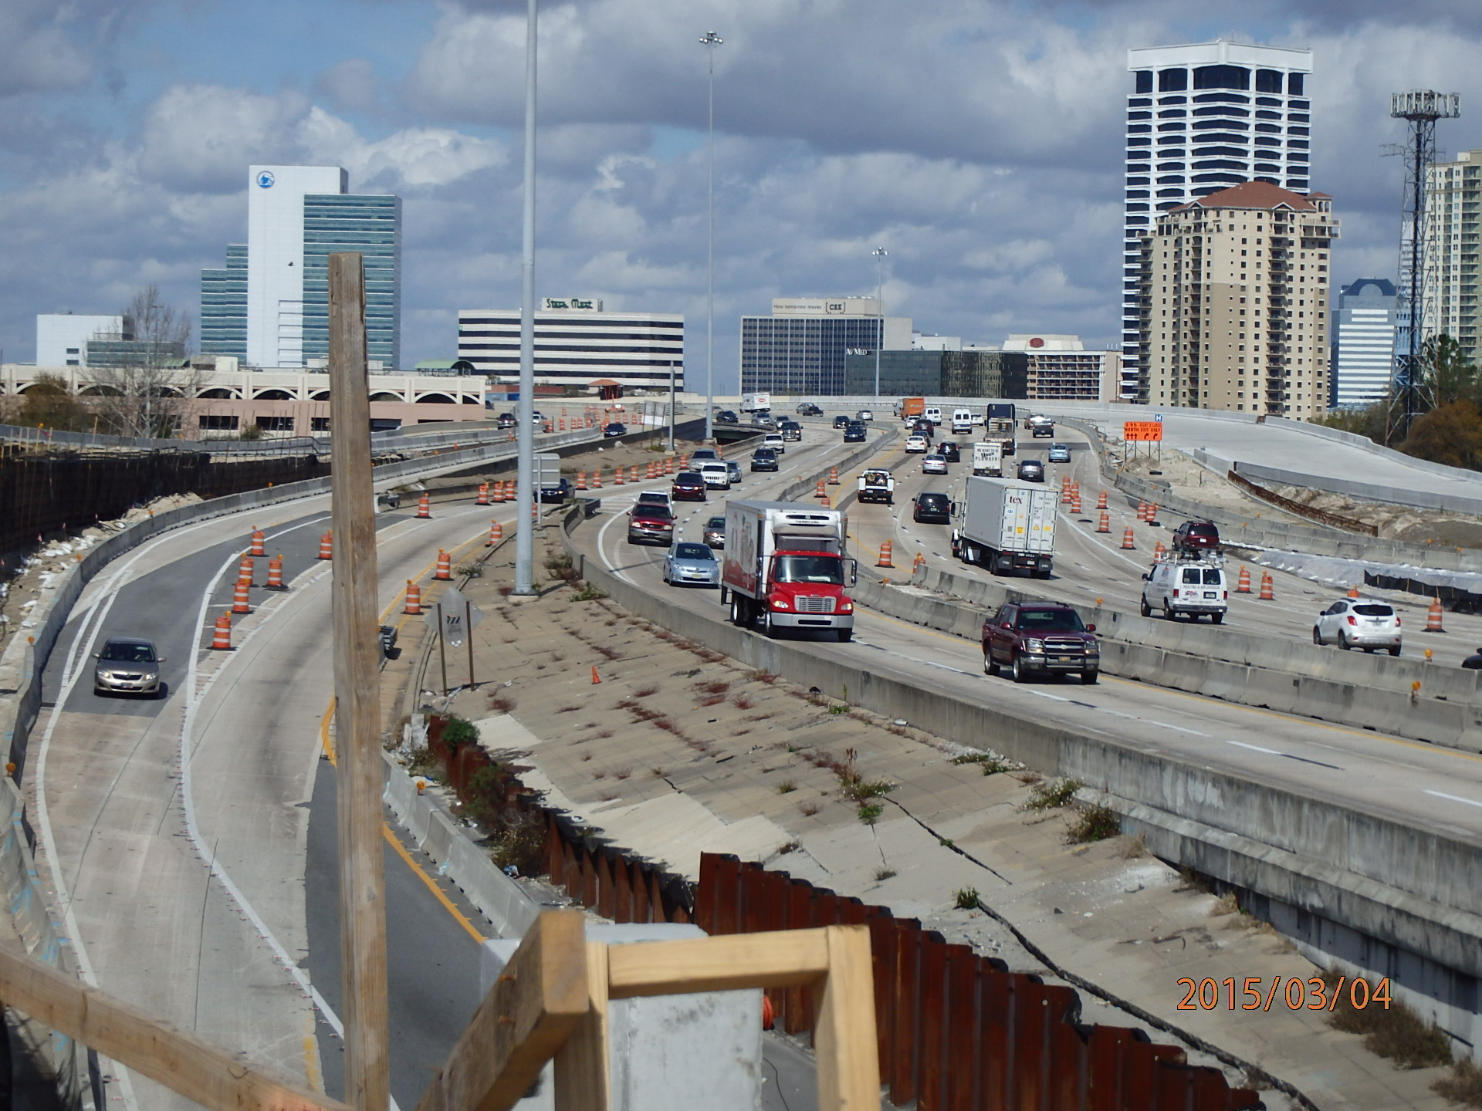
Work Zones

Slide 3
Original Maintenance of Traffic
Notes:
Patrol car at scene and maybe another at the end of the traffic backup

Slide 4
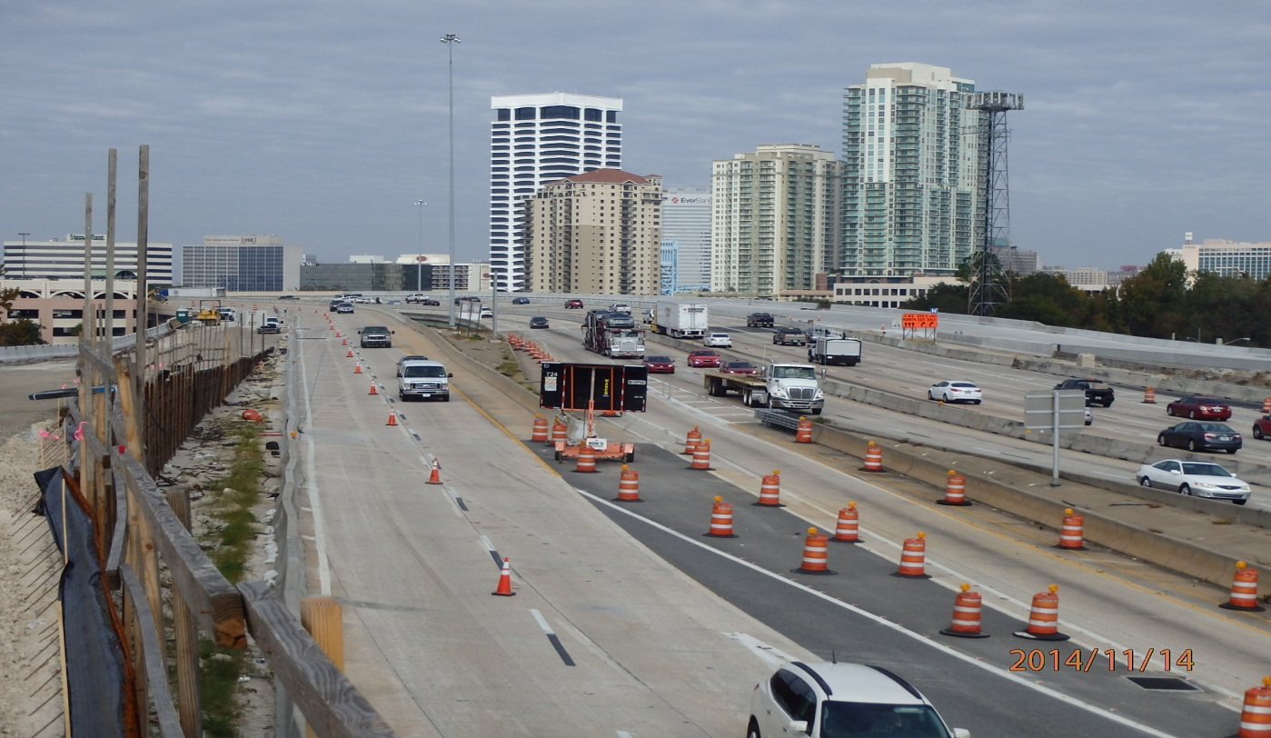
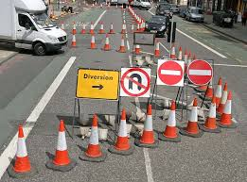
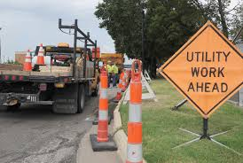
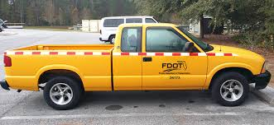
Maintenance of Traffic
Notes:
Florida and other states have moved from DOT employees and trucks to Asset Management where contractors provide MOT and other services related to work zones and cleanup.

Slide 5
Traffic Incident Management Training

Slide 6
Special Circumstances
Traffic Homicide Investigations
Laser Mapping
Robotic technology
Hazardous material
Cargo
Spills
Roadway damage

Slide 7
Enforcement
Dedicated law enforcement personnel within closed lanes
Law enforcement personnel dedicated to traffic law enforcement prior to construction zone
“Operation Hard Hat”
Enhanced penalties (double-fines)
Notes:
ODPE
Hireback
Enhanced penalties 10-15 over is $304, 15-19 over is $404, 20-29 over is $454 and anything 30 mph over the limit is a mandatory court appearance.

Slide 8
Planning and Coordination
Florida DOT
Traffic Incident Management Teams
CTST (Community Traffic Safety Teams)
Construction progress safety meetings
Other First Responders
Special events considerations
Traffic Management Centers
Enhanced penalties

Slide 9
Services
Road Ranger program
“Safe Tow” program
RISC (Rapid Incident Scene Clearance)
Florida 5-1-1
Dynamic Message Signs
Crash investigation areas

Slide 10
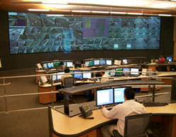
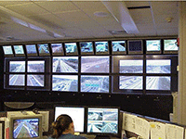
Traffic Management Centers
FDOT District 4
South Florida
FDOT District 2
Northeast Florida

Slide 11
5-1-1 and GPS Devices
Cell Phone Call
Computer Aided Dispatch
Advanced GPS Devices
5-1-1

Slide 12
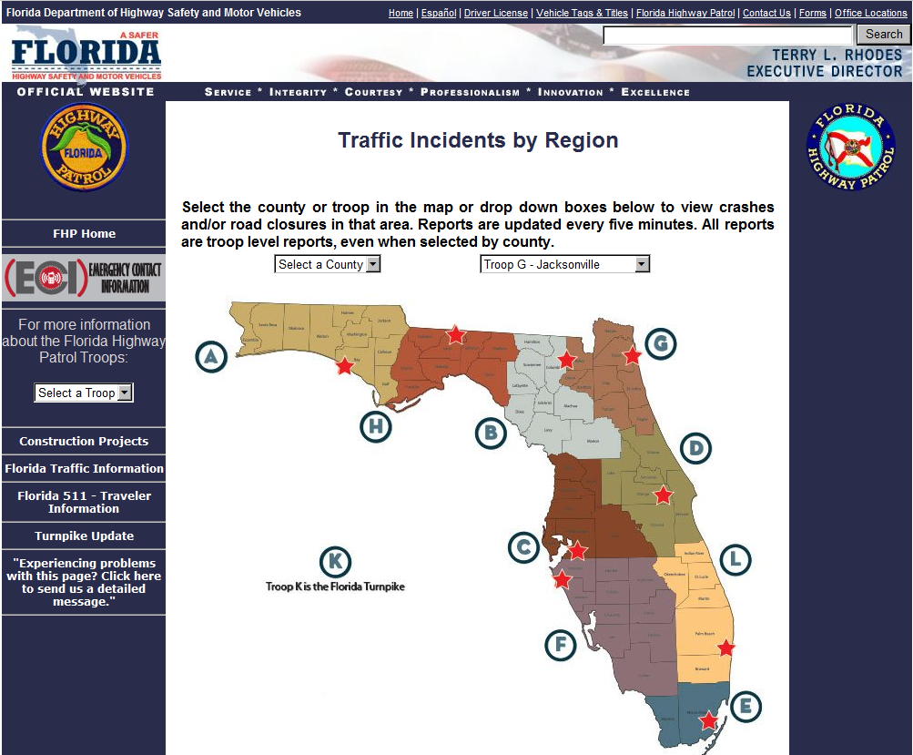

Slide 13
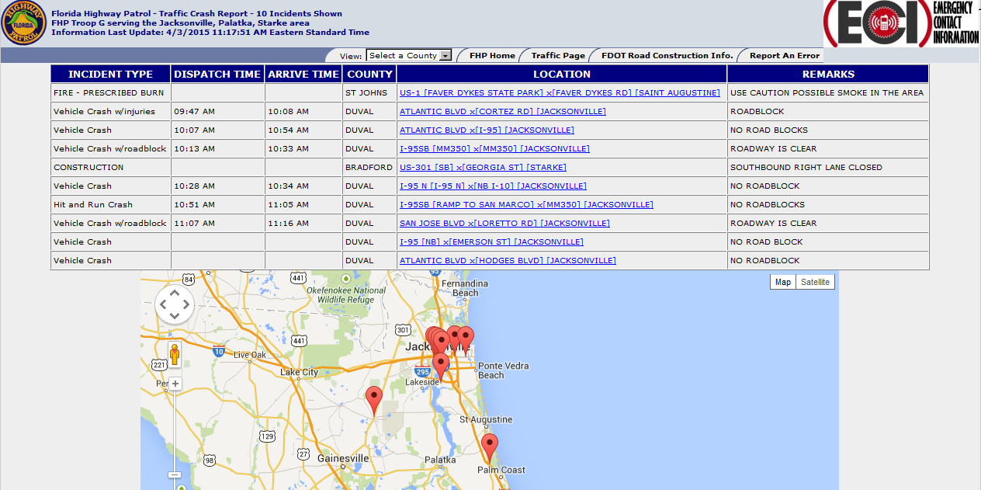

Slide 14
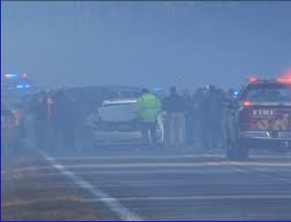

Slide 15
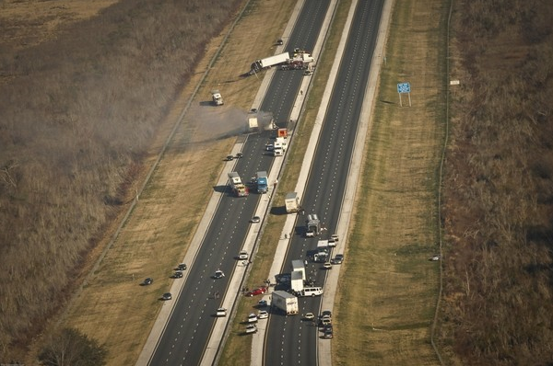

Slide 17
Florida Highway Patrol Keeping You Moving - Captain Keith Gaston

